Slide 1
The tesla
By: morgan bloom
This Photo

Slide 2
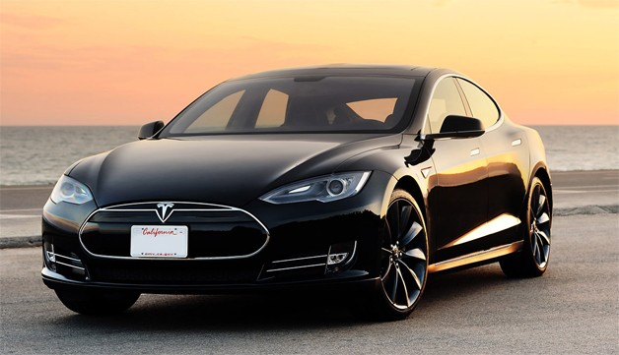
Tesla model s
- The Tesla S's motor is very small
- It has more cargo space than any other car in its class at 31.6 cubic feet
- The door handles draw back into the cars body automatically
- Its very secure and intact for example the car is roof crush resistance (tested)
- The optional panoramic sunroof is astronomical, also it blocks 98% of UV light (ultraviolet light) and 81% of the heat from the sun which means the car stays cool

Slide 3
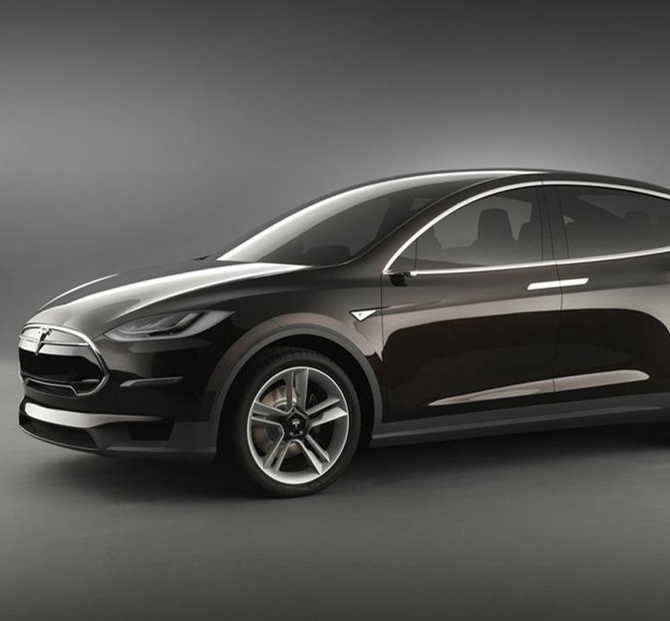
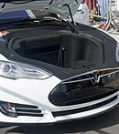
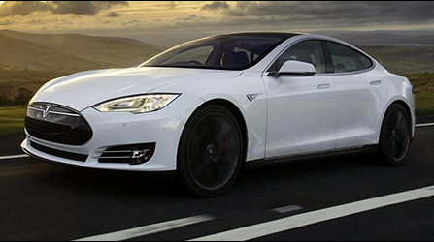
Tesla model s pictures

Slide 4
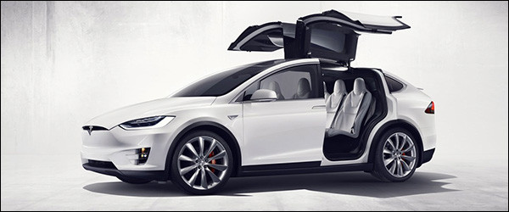
Tesla model x
C.
Model X is the safest, quickest, and most compatible sport utility vehicle in history.
Designed as family car without compromise.
Model X comes with all standard wheel drive.
It cost about $120,000.
Also it has extravagant falcon winged doors

Slide 5
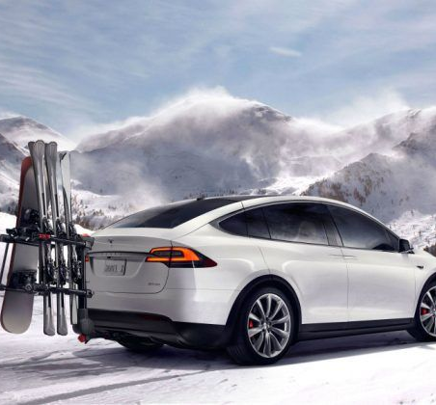
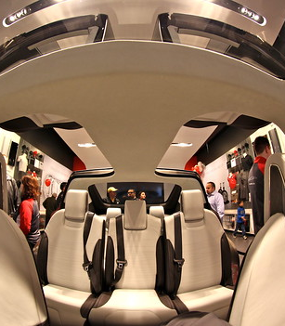
Tesla model x pictures
This Photo by Unknown author is licensed under CC BY-NC.

Slide 6
Fun facts
Tesla cars do not have any physical dials behind the steering wheel ( or anywhere else ) instead the driver is presented with a 12.3-inch LCD display ( with a resolution of 1280x480
There are 4 tesla models including the tesla model 3,S,X, and Y

Slide 7
Any questions??????????????????
.

Slide 8
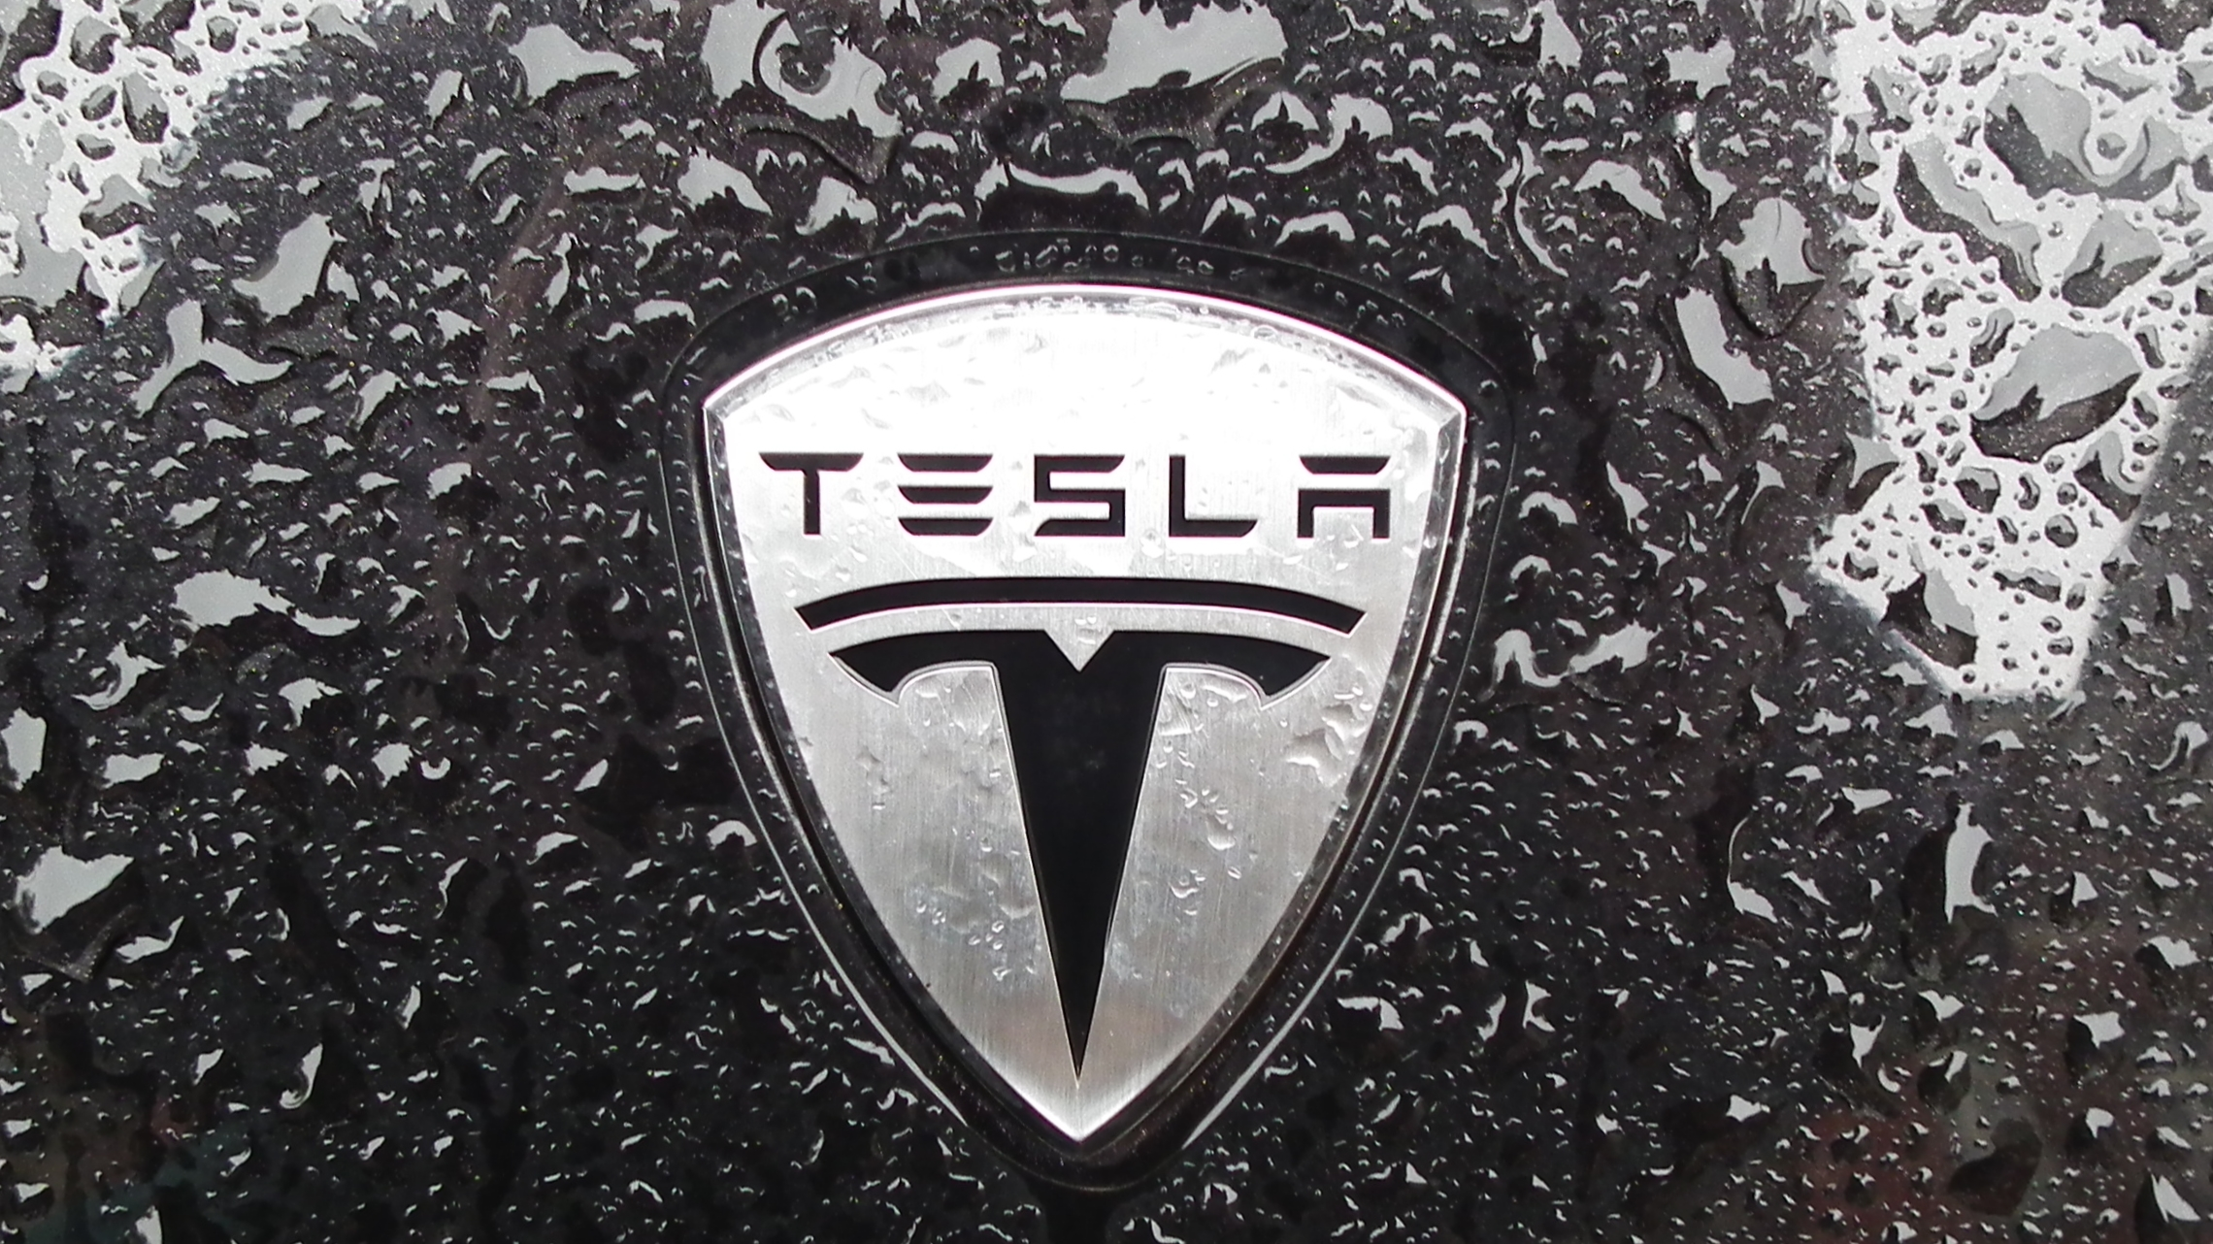
Thank you

