Slide 1
Tardigrades
By: Zoe Zitin
This Photo by Unknown author is licensed under CC BY-NC.

Slide 2
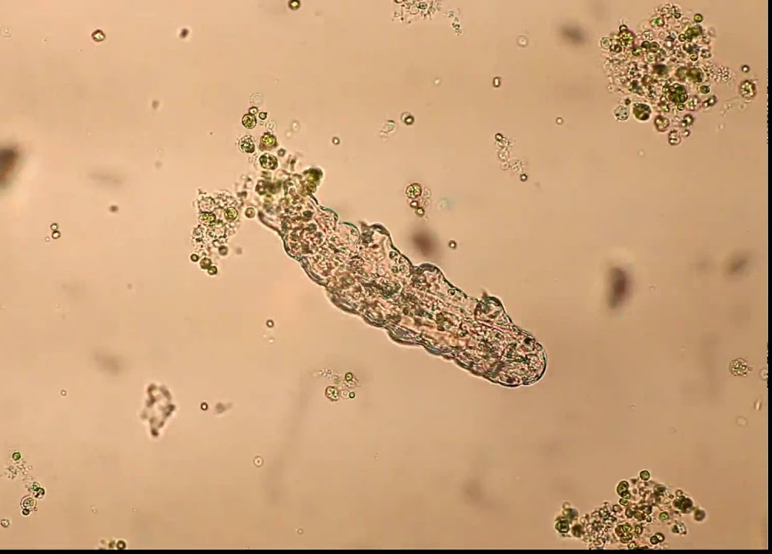
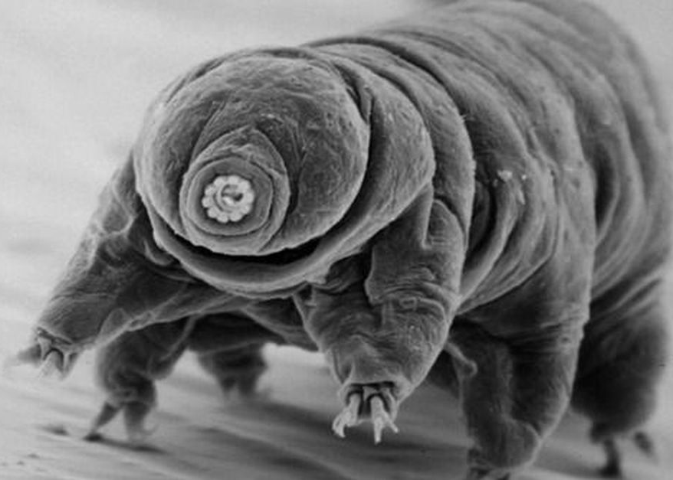
What is a Tardigrade?
A tardigrade, also known as water bears, are tiny microscopic creatures that can survive really any condition. They only have about 1,000 cells in their body, but they are amazing animals.

Slide 3
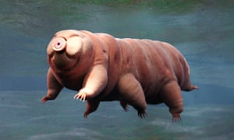
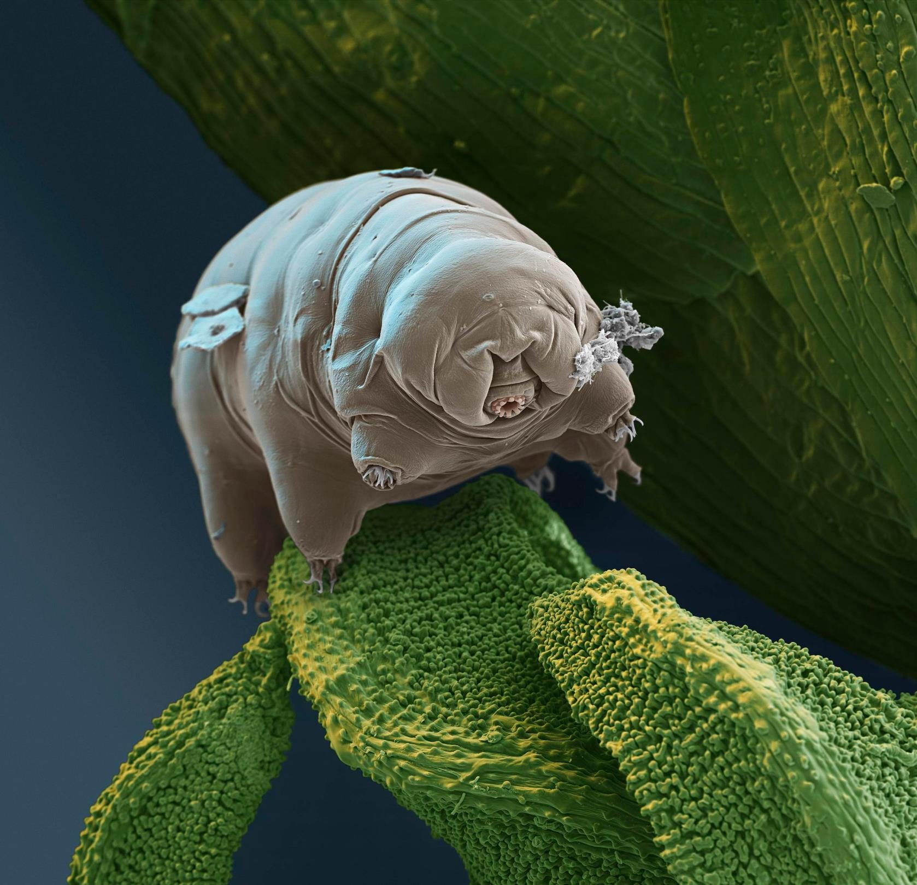
Where can they survive?
These water bears are tiny, but don't underestimate them by size. Tardigrades can live in so many conditions that we could never imagine living in. Although they prefer to live in moist atmospheres, they can live up to anywhere.
They can live in freezing climates down to 328 degrees Fahrenheit
Tardigrades can survive in the hottest conditions up to 300 degrees F
These bacteria can survive radiation and a gigantic amount of pressure, they can also survive dehydrated
Most impressively, water bears can live in the space vacuum without oxygen

Slide 4
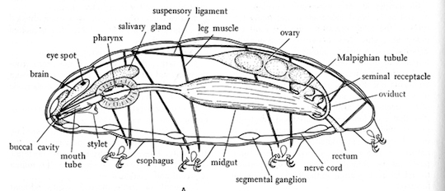
The parts of a water bear
A water bear has many parts to its body, but these are its main body parts. It has a small round body with four pair of legs on its torso (0.3 to 0.5 mm) and it has a small stubby head attached at the front.
This is a more complex diagram of a tardigrade.

Slide 5
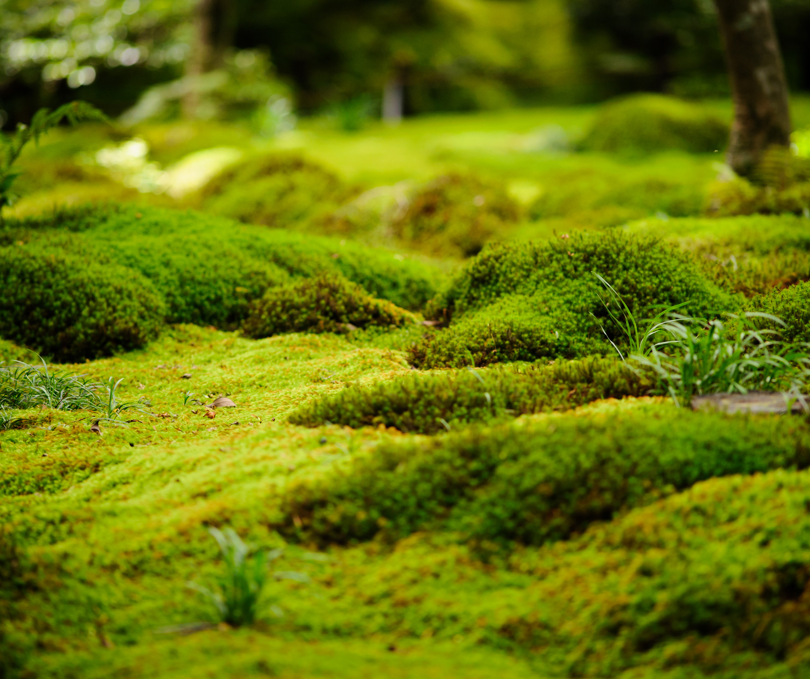
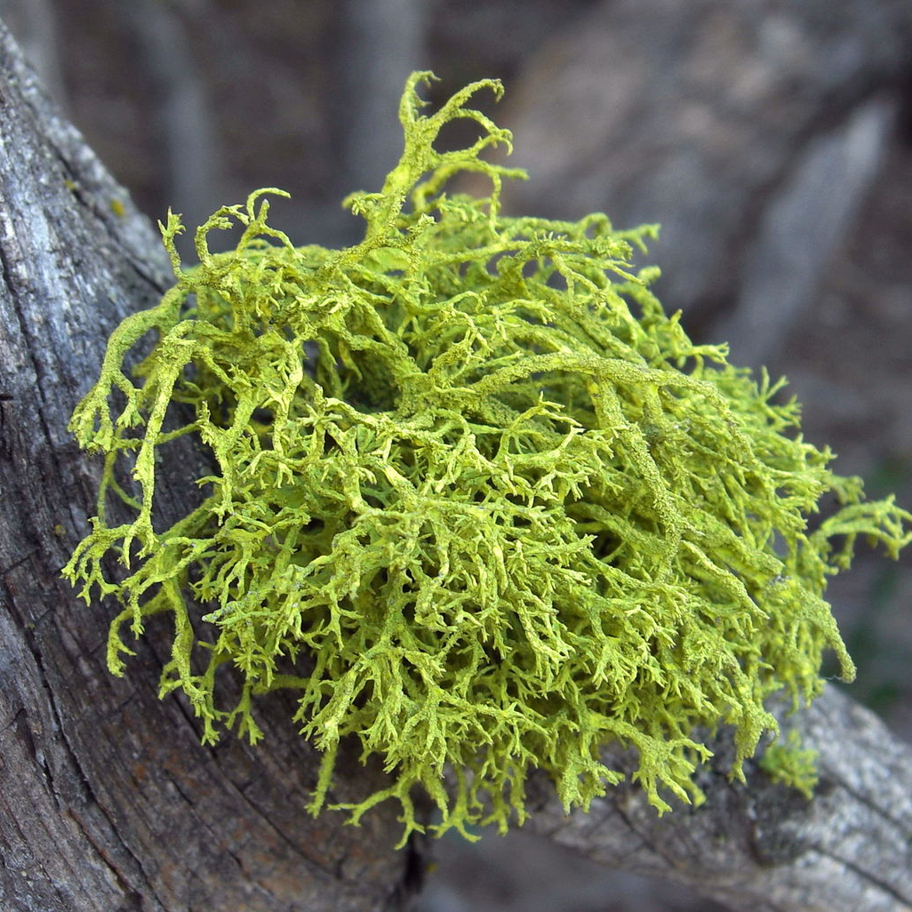
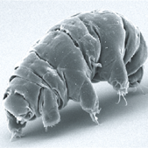
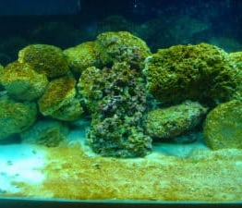
What do they eat?
Tardigrades take out juices from algae, lichens, and moss. Some even prey upon other tardigrades for food.
This Photo by Unknown author is licensed under CC BY-SA.
This Photo by Unknown author is licensed under CC BY-SA.

Slide 6
This Photo by Unknown author is licensed under CC BY-SA-NC.

Slide 7
1.) What do they eat? pick 2 answers
Moss
Humans
Lichen
Water bottles
This Photo by Unknown author is licensed under CC BY-SA.

Slide 8
2.) About how many cells are in their body?
1
200
1000
5000000000000000

Slide 9
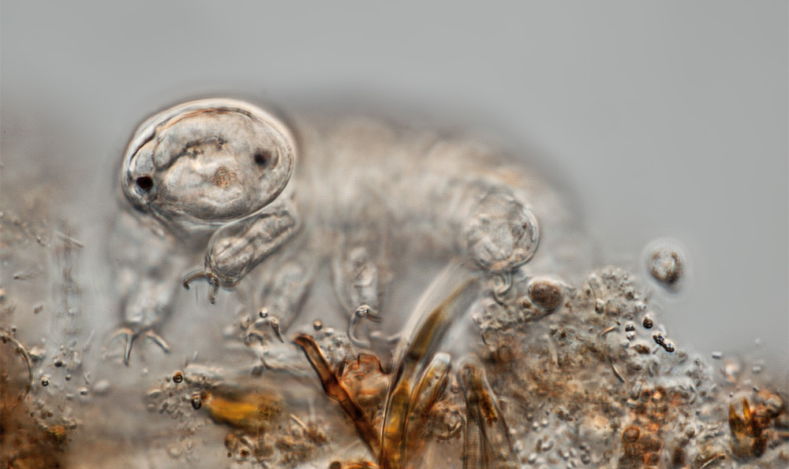
Where are three conditions, they can survive in?
This Photo by Unknown author is licensed under CC BY-SA.

Slide 10
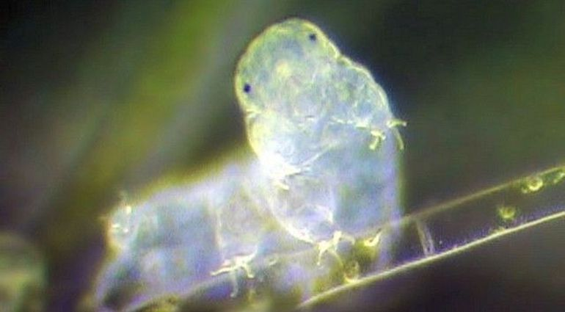
Conclusion
Water bears are interesting creatures, although they can be unpleasant to look at, they are quite amazing animals.

