Slide 1
Super Animals
By Malachi Hodges

Slide 2
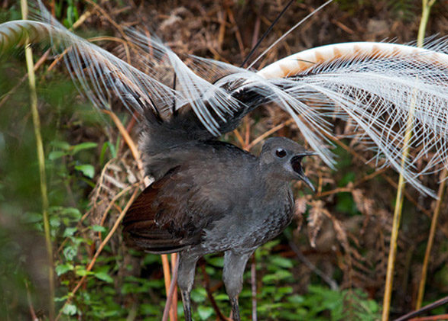
Lyre Bird
This bird can mimic other bird sounds and animals plus anything it hears. It can do this because the bird has the most complex searings of all songbirds.
This Photo by Unknown author is licensed under CC BY-ND.
This Photo by Unknown author is licensed under CC BY-SA.

Slide 3
Gecko
Geckos can see in the near darkness and they can see hundreds of colors. They can hyperextend There toes backwards and they can walk on walls and ceilings. They have transect membranes on their eyes to keep them moist.
This Photo by Unknown author is licensed under CC BY-NC.

Slide 4
Swift
This bird can go 125 mph they can do this because of their unique wing structure which maximizes their energy efficiency. They can rotate their wings at the base and allows them to generate power down stroke and up stroke so they can fly nonstop for ten months!
This Photo by Unknown author is licensed under CC BY-SA.

Slide 5
Mantis Shrimp
This shrimp has a punch of a power of a 50-caliber pistol. This shrimp can break through aquarium glass! This is a predatory shrimp. This shrimp is multie colored and can be different colors depending on the parents.

Slide 6
Sea Cucumber
This sea cucumber can change its shape at will, it can use it for defense or to get into to small places they can do this by manipulating the collagen in its body.
This Photo by Unknown author is licensed under CC BY-ND.

Slide 7
The bombardier
This bug has two storage compartments in its abdomen where it keeps hydroquinone and hydroperoxide. Then it opens its internal valve and makes the chemical mix. In order to blast it out of its but it boils so the chemical can get out fast.
This Photo by Unknown author is licensed under CC BY-SA-NC.

Slide 8
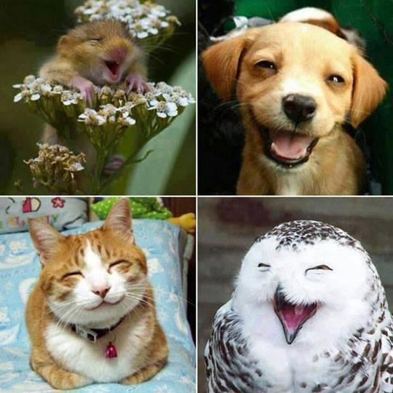
Thank You for listening!
This Photo by Unknown author is licensed under CC BY-NC.

