Slide 1
Size comparison for our solar system
By: Derek Liu

Slide 2
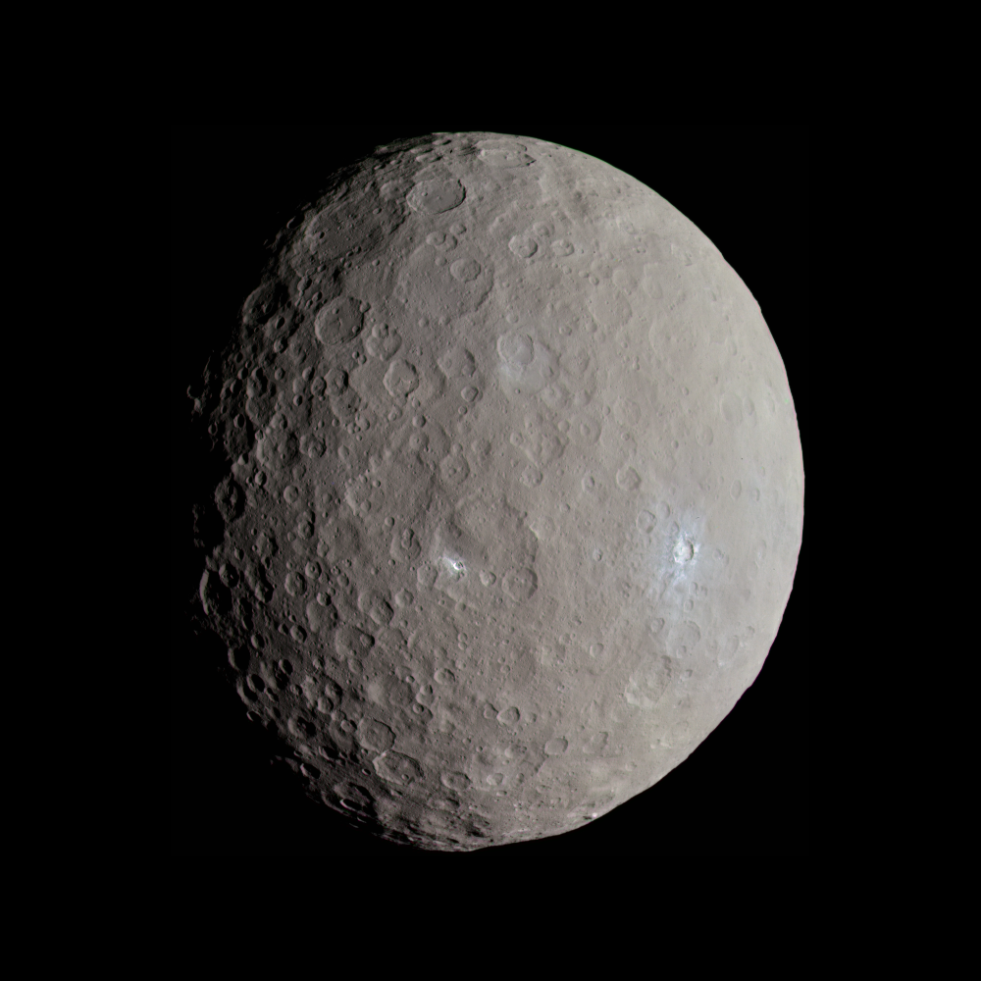
Ceres
Its radius is about 293.91 mi
Its circumference is about 1,859 mi
Its mass is about 8.958 × 10^20 kg
It's around 4.573 billion years old
Its surface area is about 2,770,000 km^2
Ceres

Slide 3
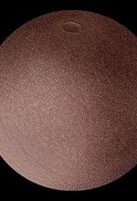
MakeMake
Its radius is about 444.28 mi
Its mass is around 3x10^21kg
It's as old as the sun 4.5 billion years
Its surface area is 6.42x10^9 km^2
This Photo by Unknown author is licensed under CC BY-SA.

Slide 4
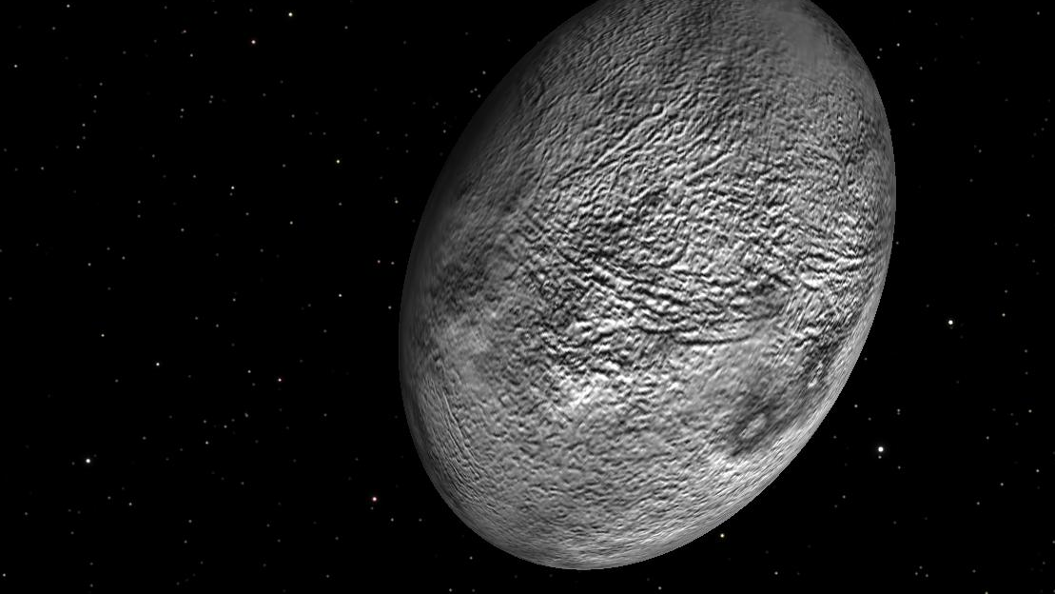
Haumea
Its radius is around 507.04 mi
At its long end haumea's circumference is 1,990 km at its short end it is just 996 km
Its mass 4.01x 10^21km
Its about 4.503 billion years old
Its surface area is about 8.14x10^6 km^2
This Photo by Unknown author is licensed under CC BY-SA.

Slide 5
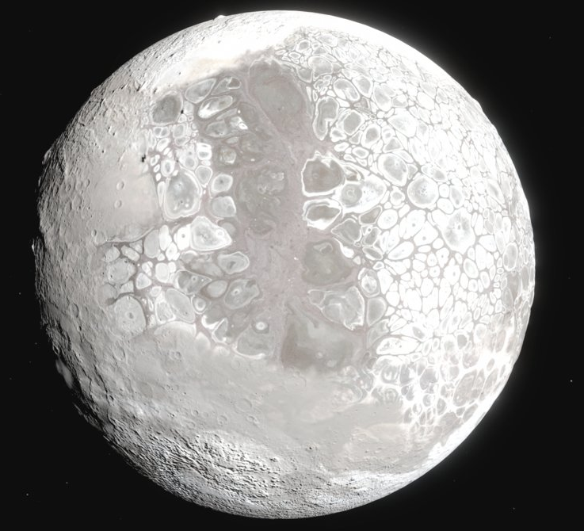
ERis
Its radius is around 722.65
Its mass is around 1.66x10^22 kg
It is around 4.503 billion years old
licen

Slide 6
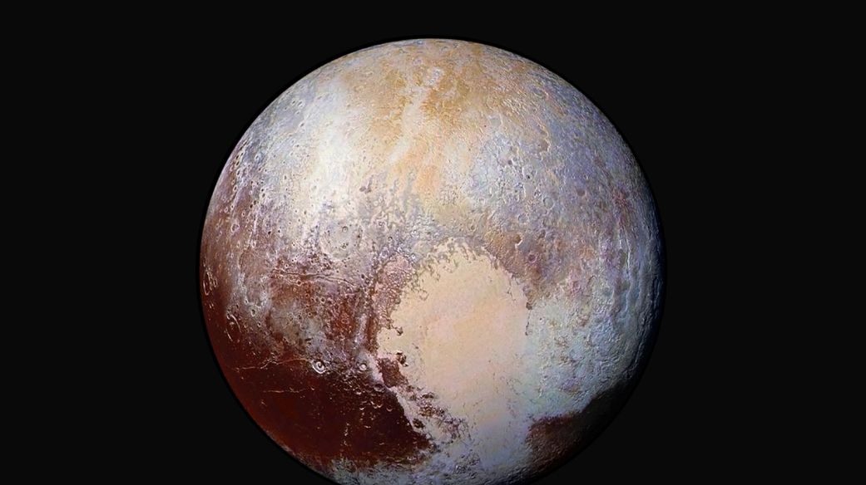
Pluto
Its radius is about 738.38 mi
Its circumference is about 4,494 mi
Its mass is about 1.30900x10^22 kg
It is around 4.6 billion years old
Its surface area is around1.67x10^7 km^2

Slide 7
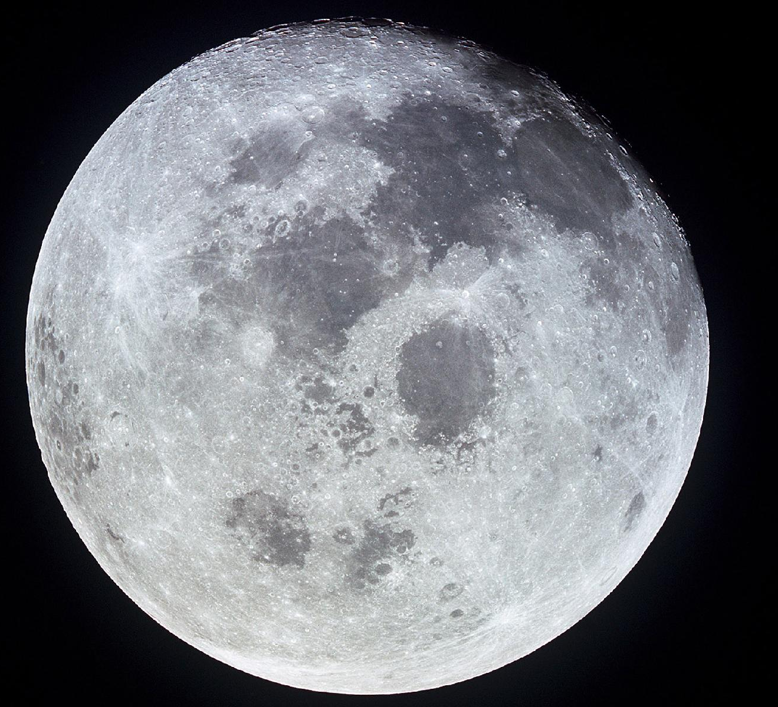
MOon
Its radius is around 1,079.4 mi
Its circumference is around 6,786 mi
Its mass is around 7.34767309x10^22 kg
It is about 4.53 billion years old

Slide 8
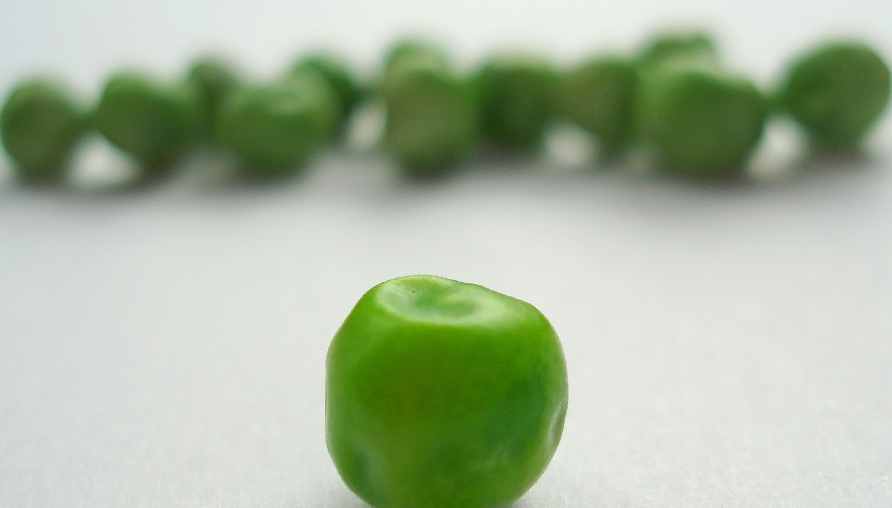
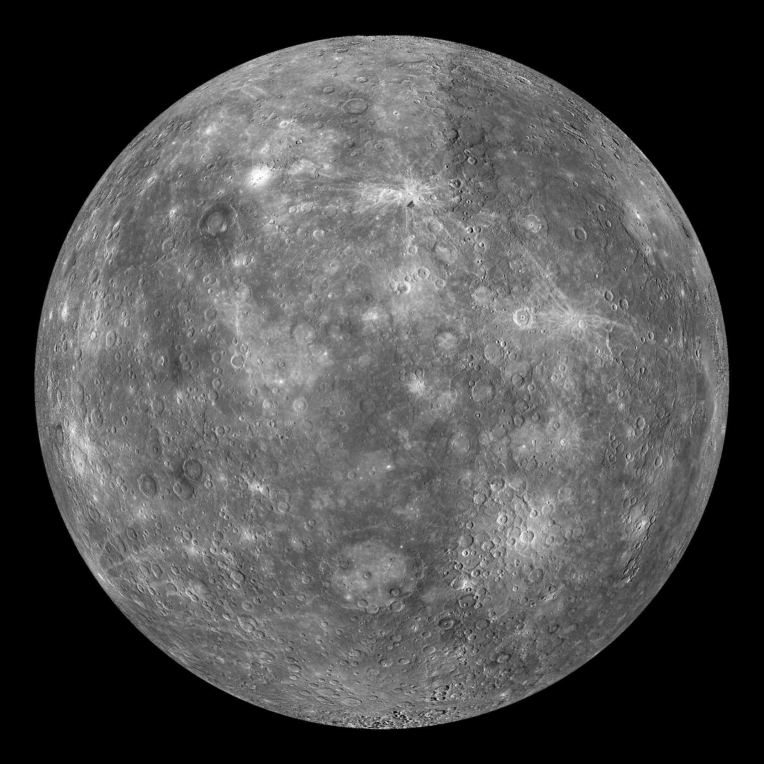
Mercury
Its radius is about 1,516 mi
Its circumference is around 9,521.1 mi
Its mass is around 3.285x10^23
It's about 4.503 billion years old
Its surface area is around 28.88 million mi^2
This Photo by Unknown author is licensed under CC BY-ND.
This Photo by Unknown author is licensed under CC BY-NC-ND.

Slide 9
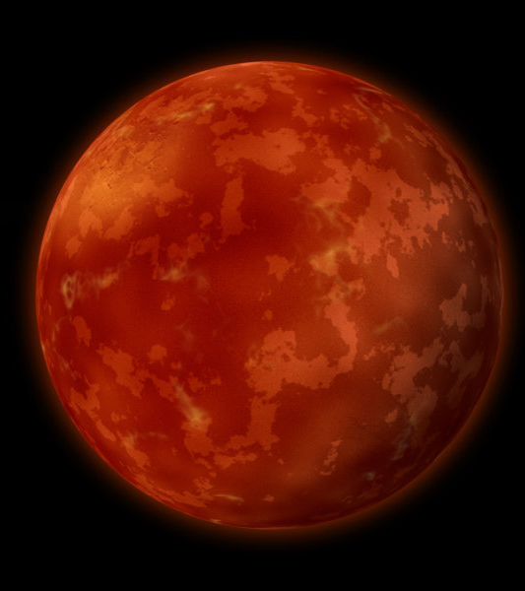
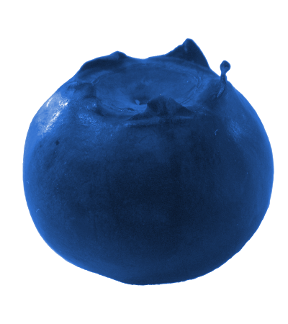
Mars
Its radius is about 2,106 mi
Its circumference is around13,263 km
Its mass is about 6.39x10^23 kg
It's about 4.603 billion years old
Its surface area is around 55.91 million mi^2
CC BY.

Slide 10
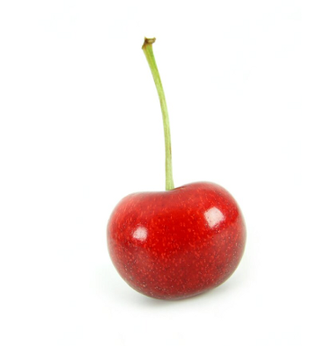
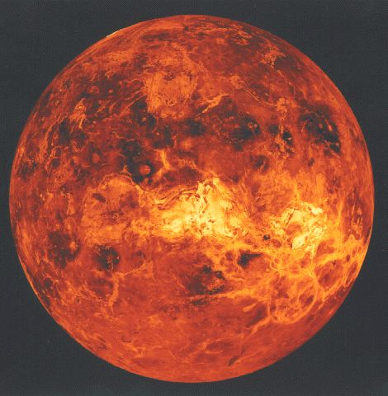
Venus
Its radius is about 3,760.4 mi
Its circumference is about 38,025 km
Its mass is around 4.867 × 10^24 kg
It is 4.503 billion years old
It surface area is around 177.7 million mi²

Slide 11
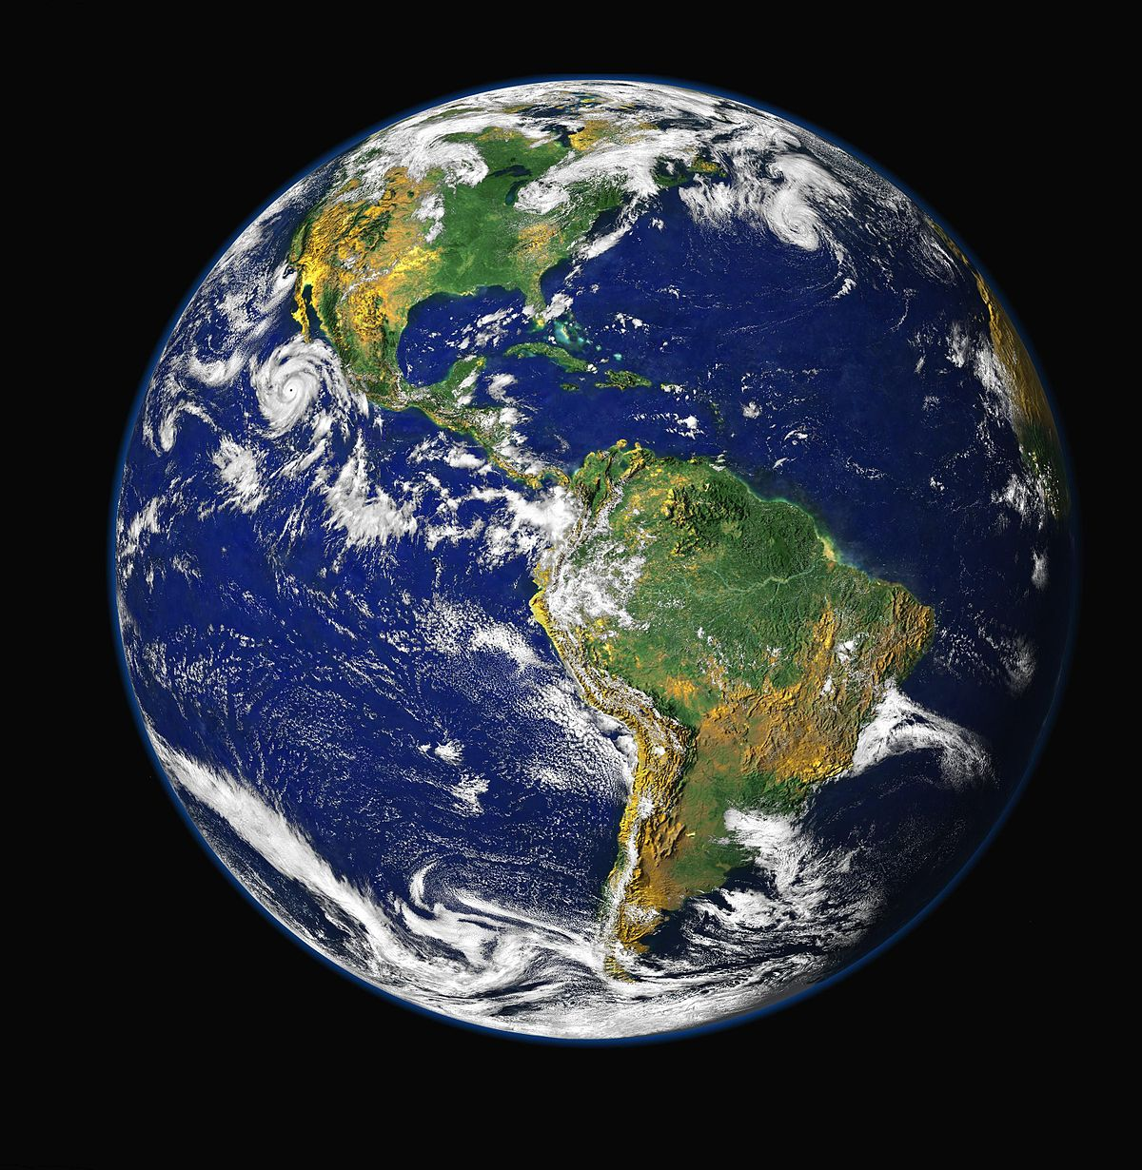
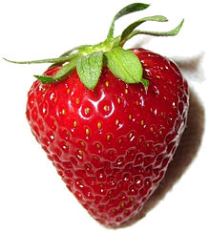
Earth
Its radius is about 3,958.8mi
Its circumference is 40,075 km
Its mass is about 5.972 X 10^24 kg
It's about 4.543 billion years old
Its surface area is about 196.6 million mi^2
This Photo by Unknown author is licensed under CC BY-SA.
This Photo by Unknown author is licensed under CC BY-SA.

Slide 12
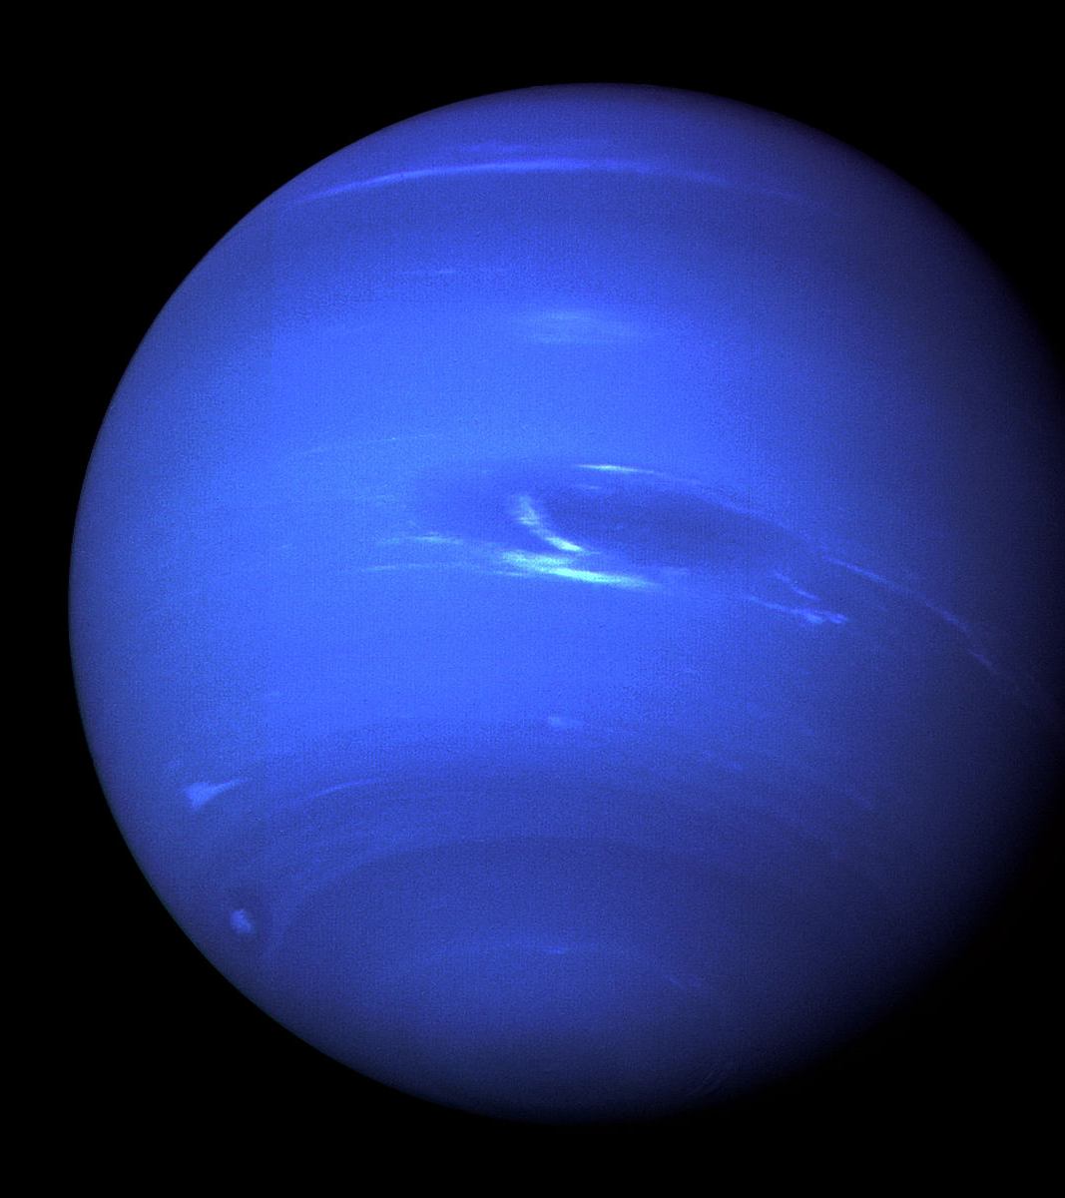
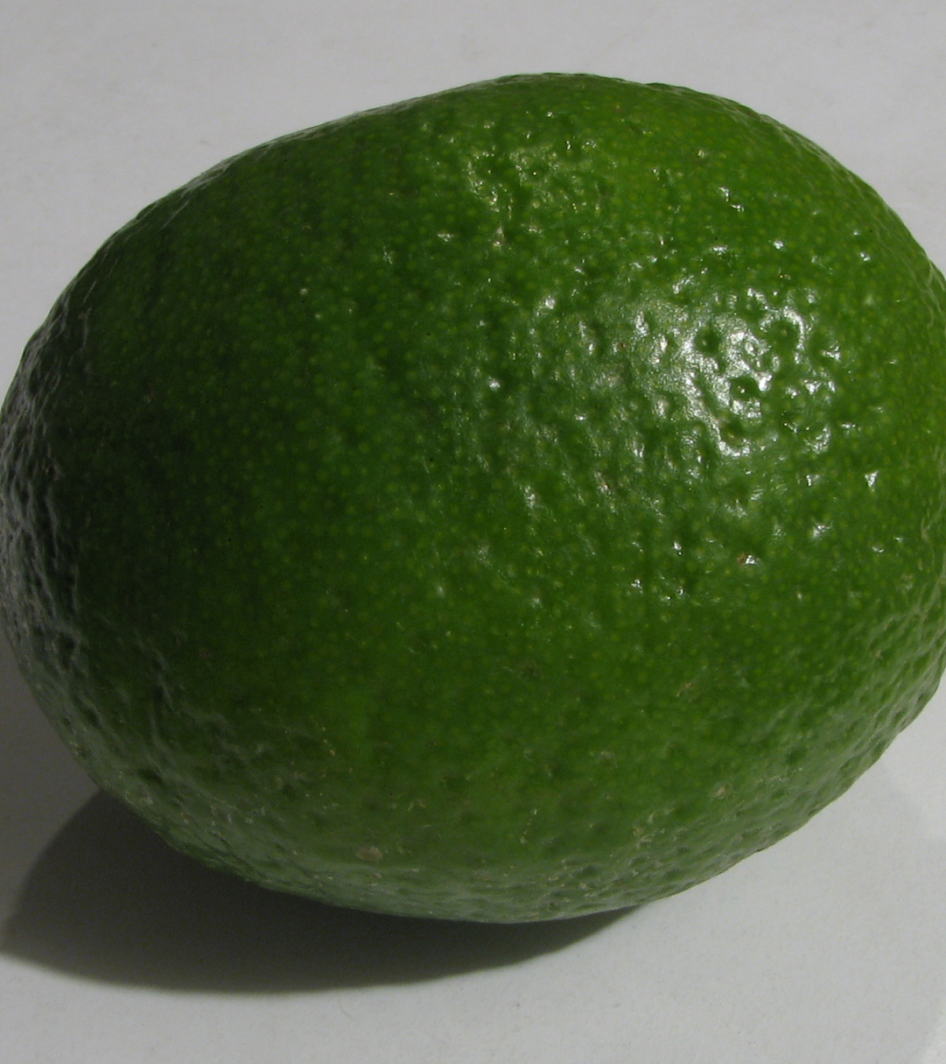
Neptune
Its radius is around 15,299 km
Its circumference is around 155,600 km
Its mass is about 1.024 × 10^26 kg
It is about 4.503 billion years old
Its surface area is about 2.941 billion mi²
This Photo by Unknown author is licensed under CC BY-SA.
This Photo by Unknown author is licensed under CC BY-SA.

Slide 13
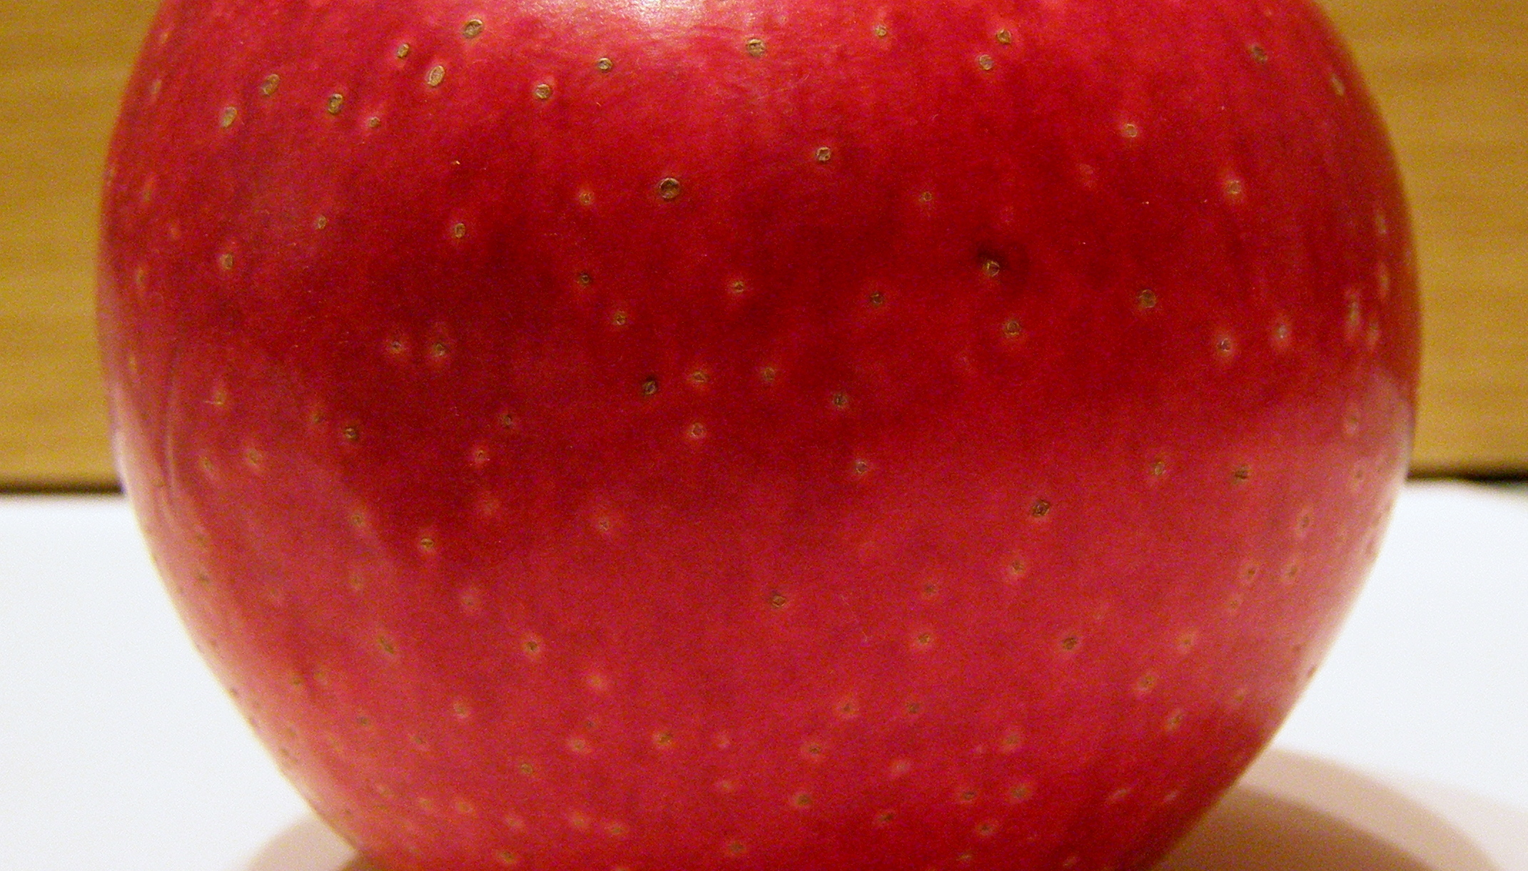
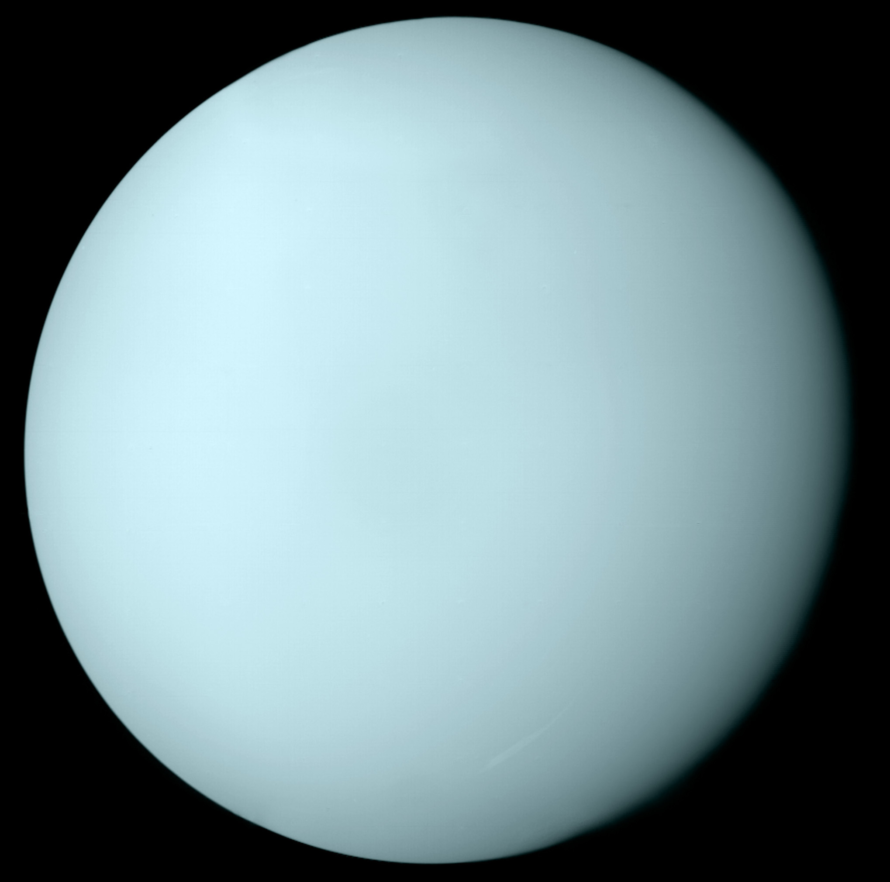
Uranus
This Photo by Unknown author is licensed under CC BY-SA.
*Scientist say it smells like fart
Its radius is about 15,759
Its circumference is about 160,590 km
Its mass is around 8.681 × 10^25 kg
It's about 4.503 billion years old
Its surface area is about 3.121 billion mi²

Slide 14
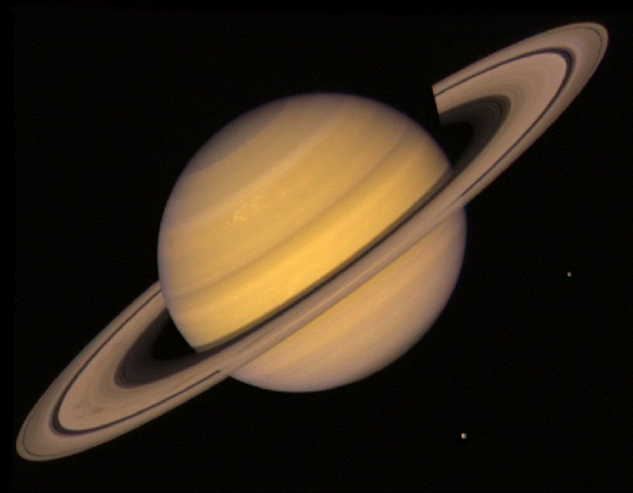
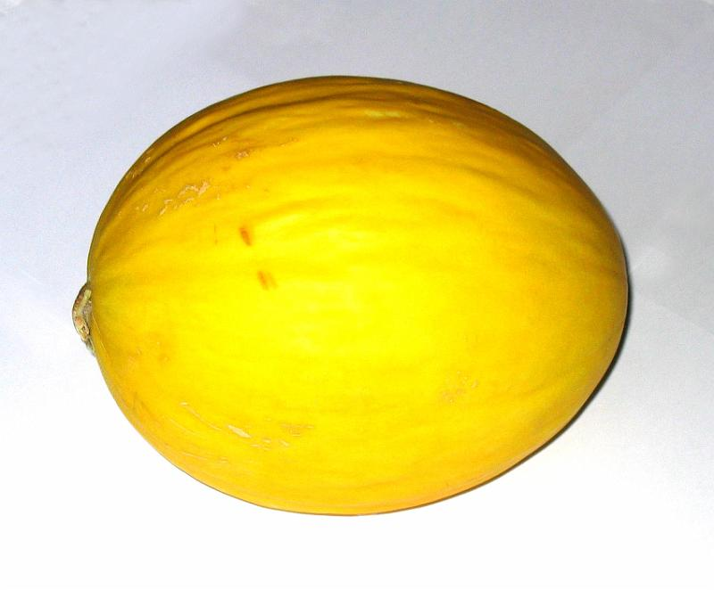
Saturn
This Photo by Unknown author is licensed under CC BY-ND.
This Photo by Unknown author is licensed under CC BY-SA-NC.
Its radius is about 36,184
Its circumference is about 378,675
Its mass is around 5.683 × 10^26 kg
It's about 4.571 billion years old
Saturn's surface area is about 16.49 billion^2

Slide 15
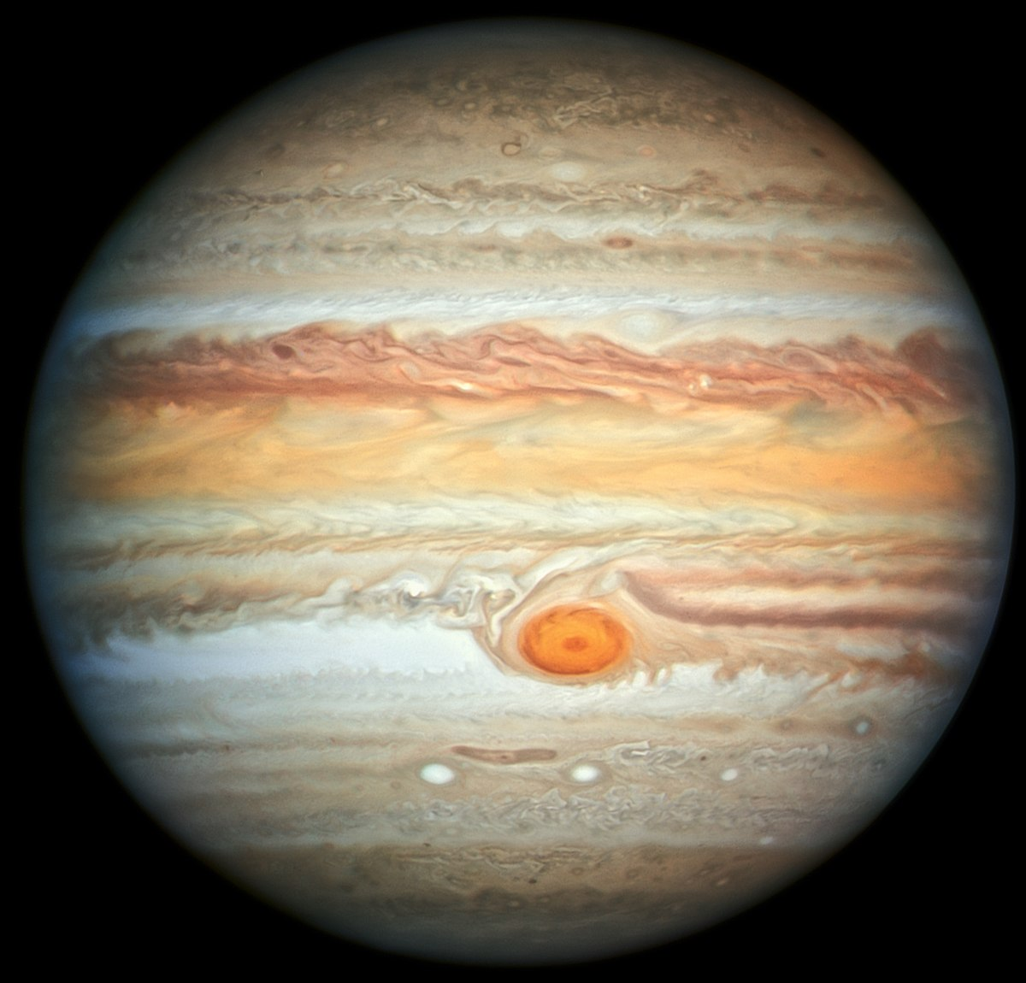
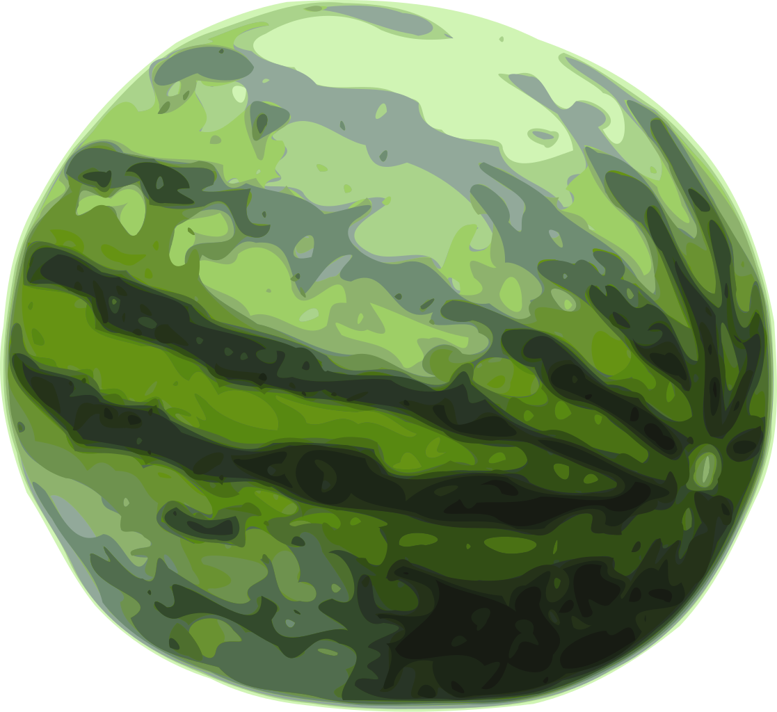
Jupiter
This Photo by Unknown author is licensed under CC BY-SA.
Its area is about 43,441 mi
Its circumference is around 439,264 km
Its mass is around 1.898 × 10^27 kg
It's about 4.503 billion years old
Its surface area is around 23.71 billion mi²

Slide 16
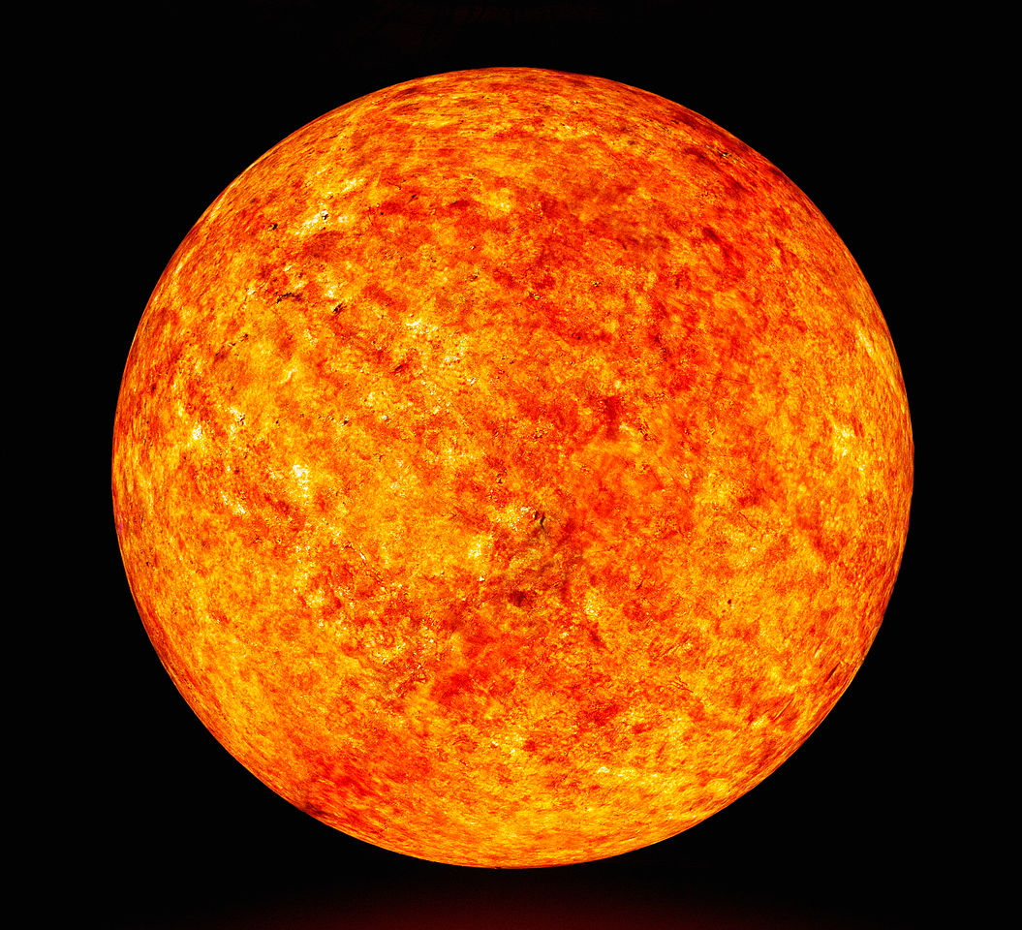
Sun
Its radius is about 696,340 km
Its circumference 4.379 million km
Its mass is around 1.989 × 10^30 kg
The sun is around 4.603 billion years old
The sun's surface area is 6.09×10¹² km² 12,000 × Earth
This Photo by Unknown author is licensed under CC BY-SA.

Slide 17
Thanks for watching
https://www.youtube.com/watch?v=ampcQYXHkM4

Slide 18
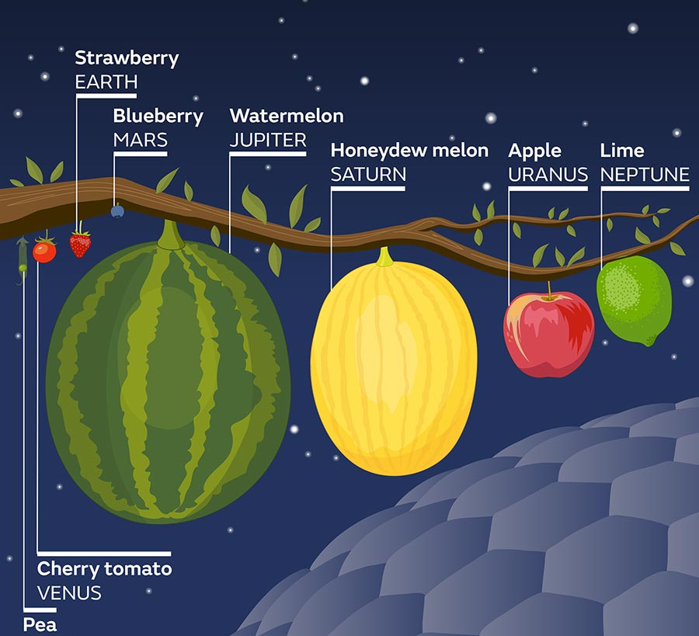
This is the solar system in FRUITS!

