Slide 1
Technology evolving
By: me, aka joe AKA THE BEAST!!!!! Ok fine... I'm not the beast! :(

Slide 2
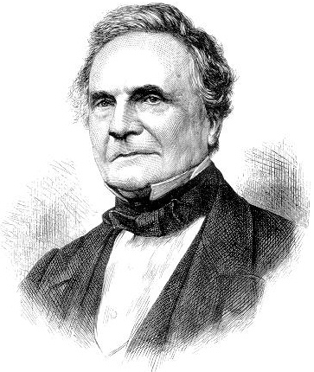
Computer
Charles Babbage invented the first mechanical computer in the year 1832 and believe it or not, the first ever computer was the size of this classroom because it was so huge and took so many wires! He started to work on it in the year of 1831 but finished a year later. Over a thousand people helped Charles Babbage build the now famous computer

Slide 3
Laptops
The laptop was invented by Adam Osborne in 1981. It was called ''Osborne 1'' and cost $1,795. It came bundled with $1,500 worth of programmed. It had a tiny computer screen built into it. Then that inspired other inventers and companies to evolve the laptop and soon it started to get popular! The inventers tried to make the laptops thinner so they can travel easy! Here in 2020, almost everyone knows about the laptop!

Slide 4
T.V.
Philo Farnsworth invented the T.V. on august 19, 1906. You didn’t have a remote to control the T.V with there were little nobs on the front of the T.V that you had to turn to get to the right channel. Speaking of channels, there were only about 3 channels on T.V and were all in black and white. The T.V was really small so a few centuries later, that inspired other inventers to create better and bigger ones so it would be a better experience for the watcher. Now in 2020, the T.V is a big thing to almost everyone in the world! And it all started with just one inventor.

Slide 5
Radio
The radio was invented by a guy named Guglielmo Marconi around 1890. Originally, the radio was not used for playing songs, it was used for news for those who just wanted to stay in their houses. But a few years later they realized they could play songs threw it and they could attach it to the inside of a car. Wow, the radio has come a long way all the way to 2020!

Slide 6
Smart phone!
the Smartphone was invented by IBM (International Business Machines Corporation) in 1992 many people bought the phone to see what it does. They are not used to having a phone with a screen because they only had wall phones and flip phones at the time, so it was interesting trying something new! Then a few years later 1n 2005, Steve jobs (C.E.O of apple) came out with the iPhone 2G witch came famous in a matter of years!

Slide 7
THE END
This Photo by Unknown author is licensed under CC BY-SA.
I hope you all have learned a thing or 2 about technology if you have any questions, I will be taking them now!

