Slide 1
How to get a wissahickon valley public Library Card

Slide 2
Not sure how to get a library card when the library is closed?
You can do it in four easy steps from your home because the application is online now!
A Wissahickon Valley Public Library card gives you access to all the digital resources of the library, including e-books and e-audio books. E-books are electronic books. You can access e-books and e-audio books using the library website and you can read or listen to a book even if the library is closed.
It would be FANTASTIC if all the students at Stony had a library card!

Slide 3
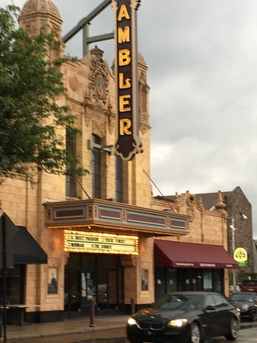
STEP 1:
Answer this question:
Do you live in Lower Gwynedd, Whitpain Township or Ambler Borough?
If the answer is YES, you can get a library card!

Slide 4
Step 2:
Fill out an application!
Important to know: The information you provide on the library application is completely confidential as the library WILL NOT share it with anyone or any agency.
This is the link to the English online application-
https://wvpl.org/sites/wvpl.org/files/2018-library-card.pdf
This is the link to the Spanish online application- https://wvpl.org/about-us/forms

Slide 5
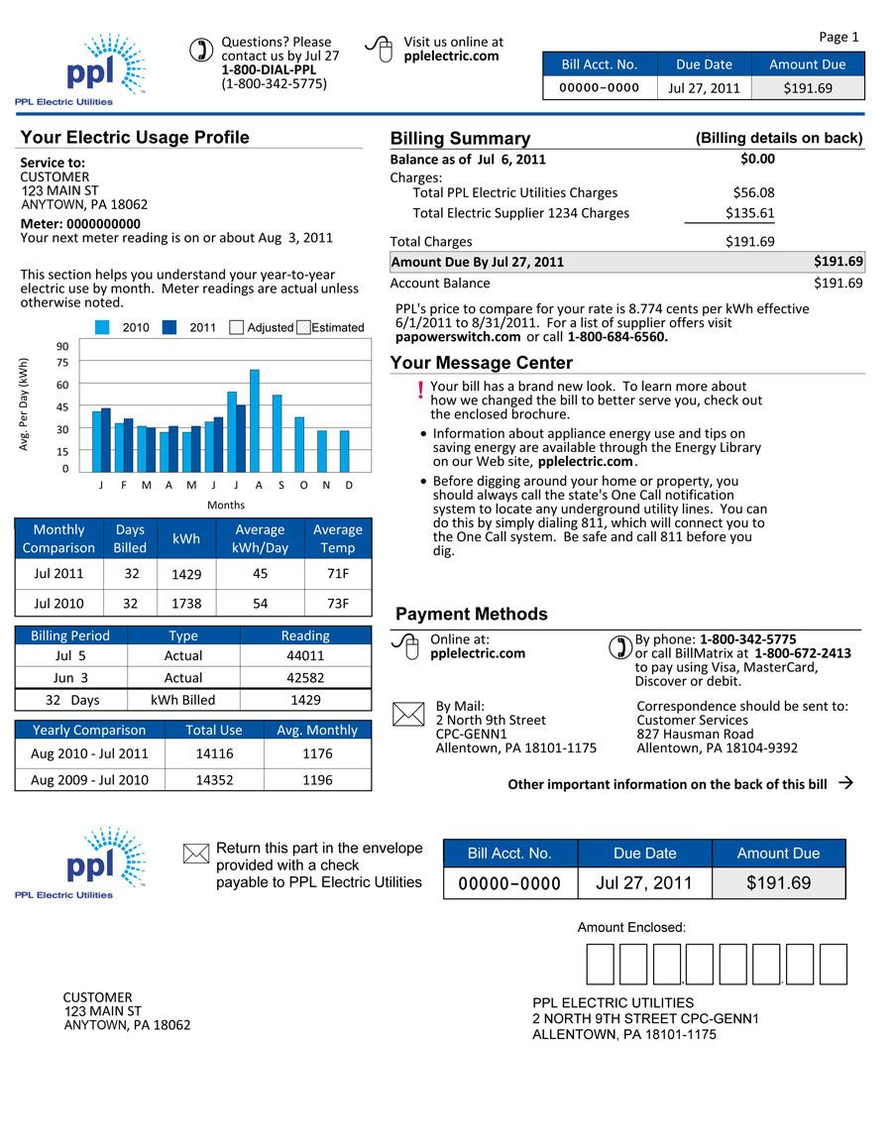
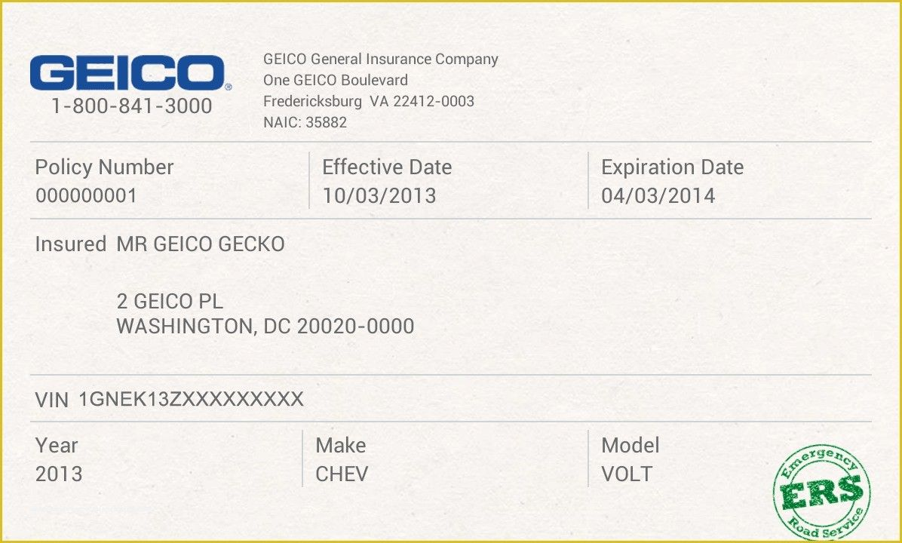
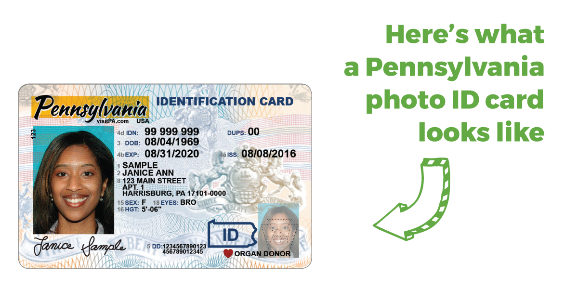
STEP 3:
In addition to filling out a library card application, you need to provide a copy or photo of one of the following with your application:
Driver’s license
State ID
Car Insurance card
Rental lease
Utility bill- gas, electric, water, etc.

Slide 6
STEP 4:
E-mail the completed application along with a copy or photo of proof of address to eshane@wvpl.org and a library card will be mailed to your home.
If you need help filling out the application or have questions or concerns, please contact Elizabeth Shane at eshane@wvpl.org for help.
would very much like all the students to have a library card.

