Slide 1
Earth
By: Kalea

Slide 2
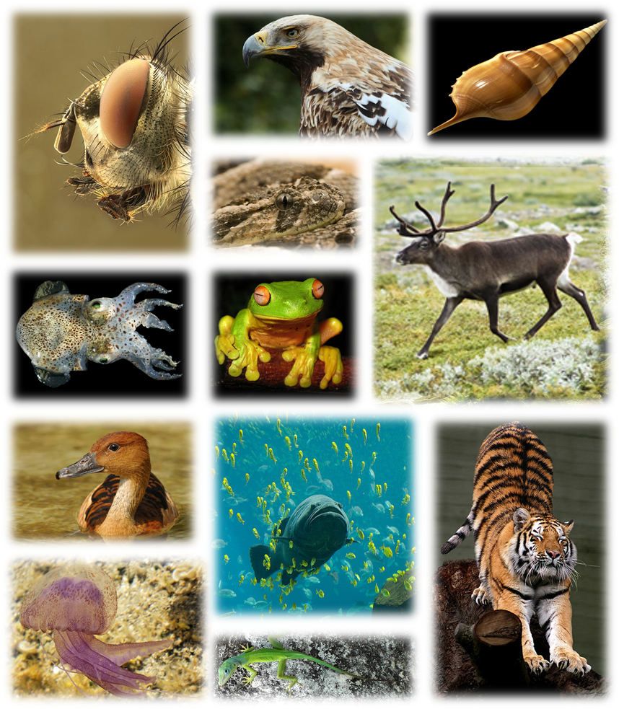
How many species are there?
There are about 8.7 million species and they believe that 1-2 million of those species are animals
This Photo by Unknown author is licensed under CC BY-SA.

Slide 3
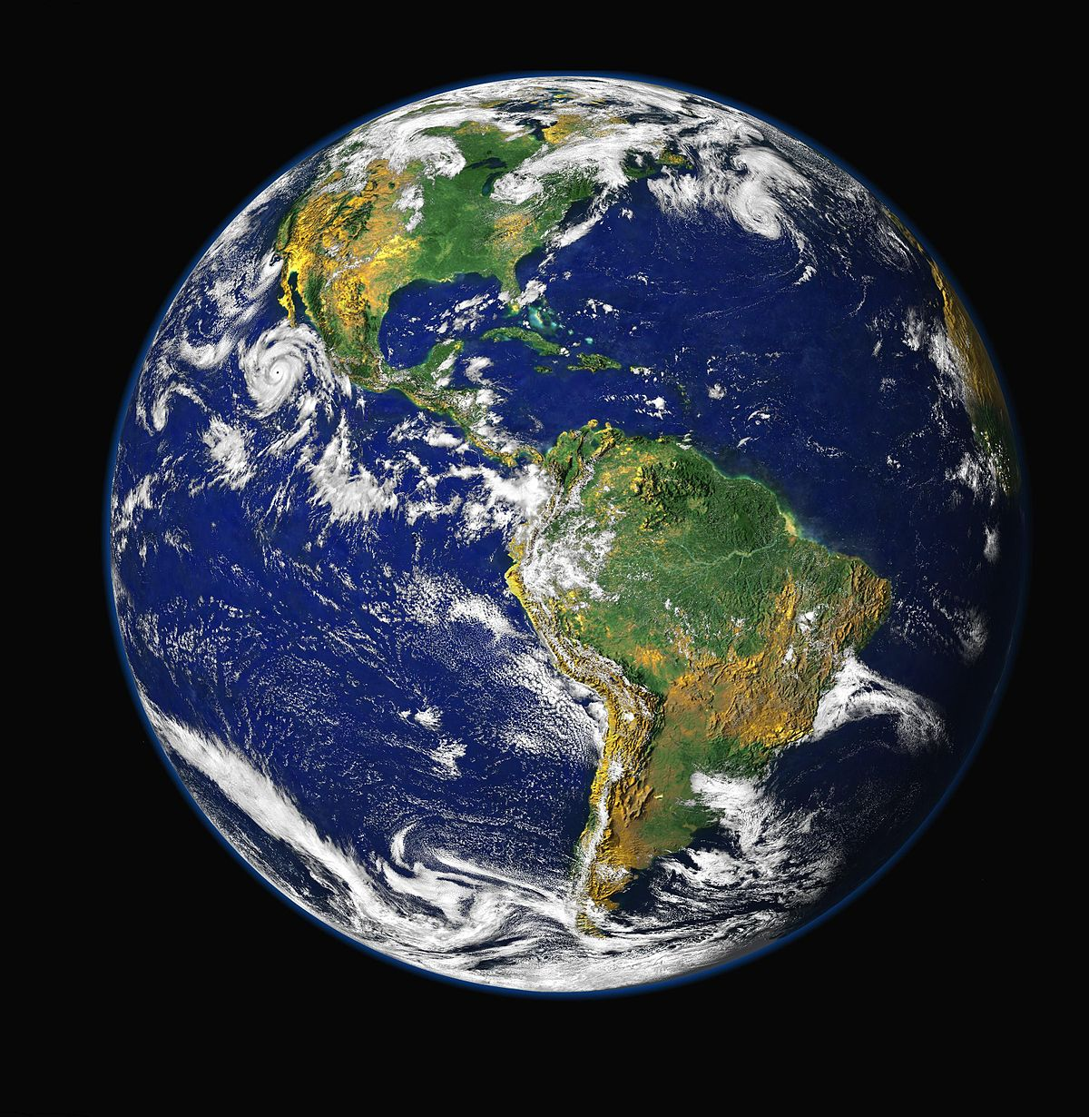
How long has the earth been around?
Earth is about 4.5 billion years old.

Slide 4
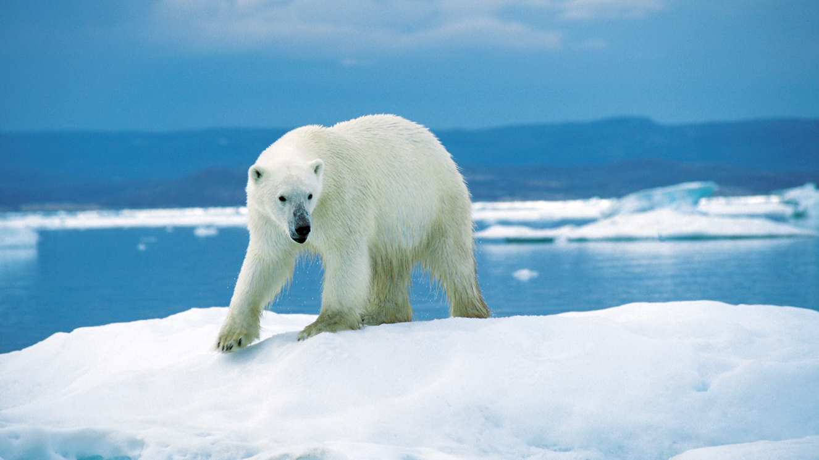
Climate
The climate is rising fast. So fast that 2019 was the second hottest year in history. So many things are being affected, because of Climate change one example is animal habitats.

Slide 5
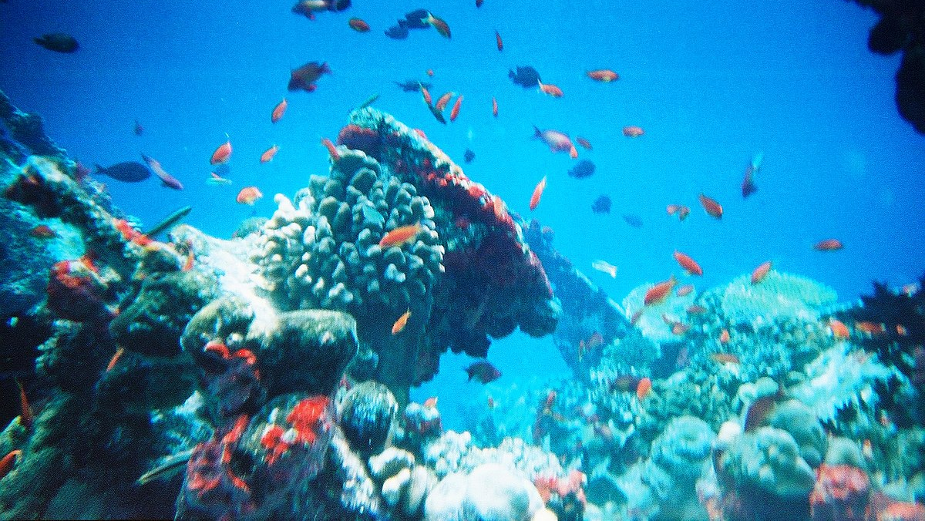
Oceans
"Less than 5 % of the planets ocean has been explored"
About 70 % of Earth is oceans
The amount if aquatic animals are between 700,000 and 1 million
On average the ocean is about 2.3 miles deep

Slide 6
Population
The three countries with the highest population are...
China
India
United States

Slide 7
GOODBYE!
Thanks for listening

