Slide 1
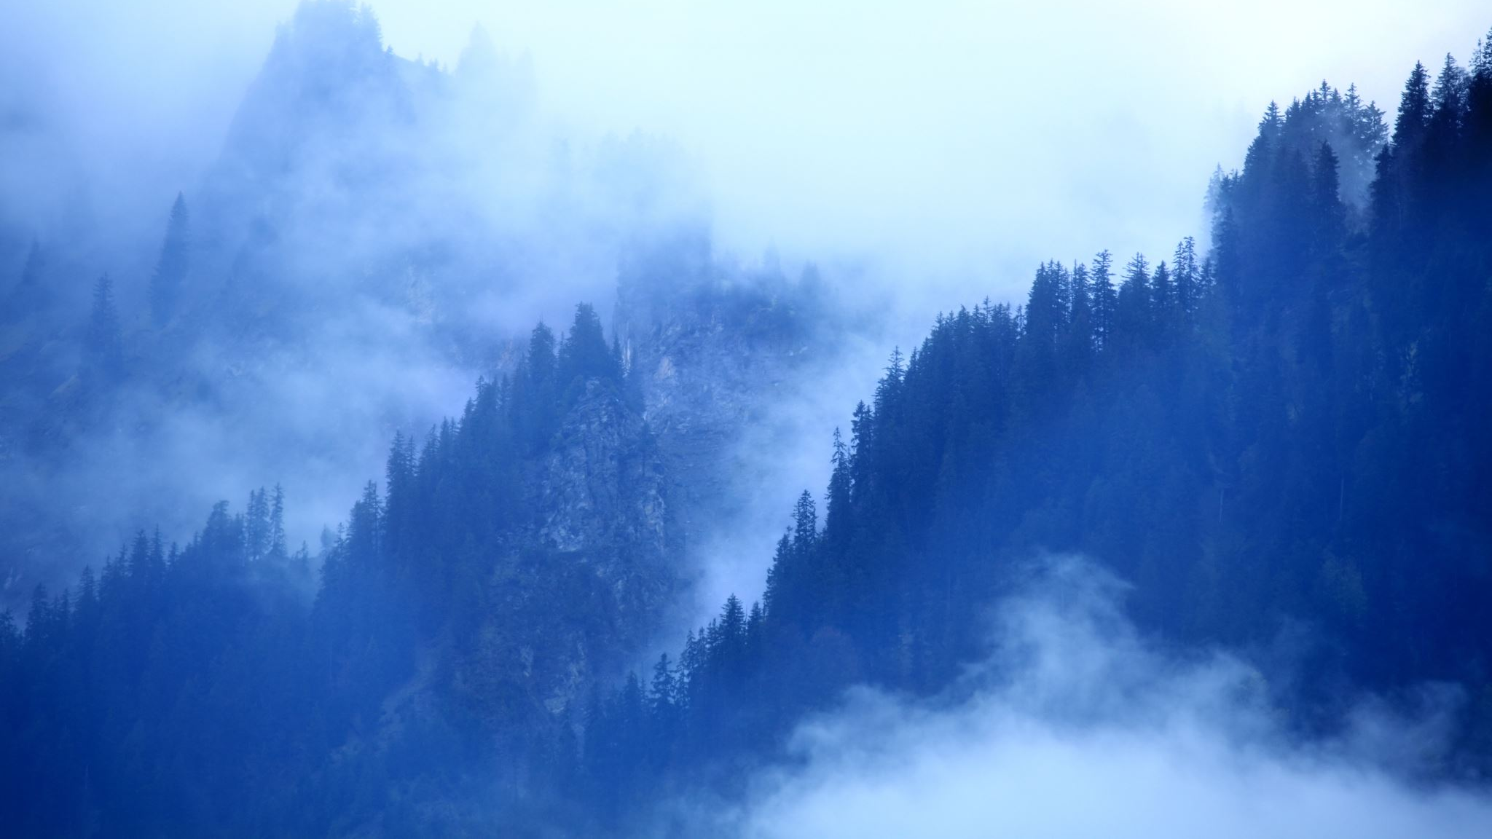
Deforestation
By: Avery Sirni

Slide 2
What is deforestation?
Deforestation is the clearing of all the trees in a specific area. Deforestation uses the suffix de- which means remove.

Slide 3
Land before and after deforestation!
Before
After

Slide 4
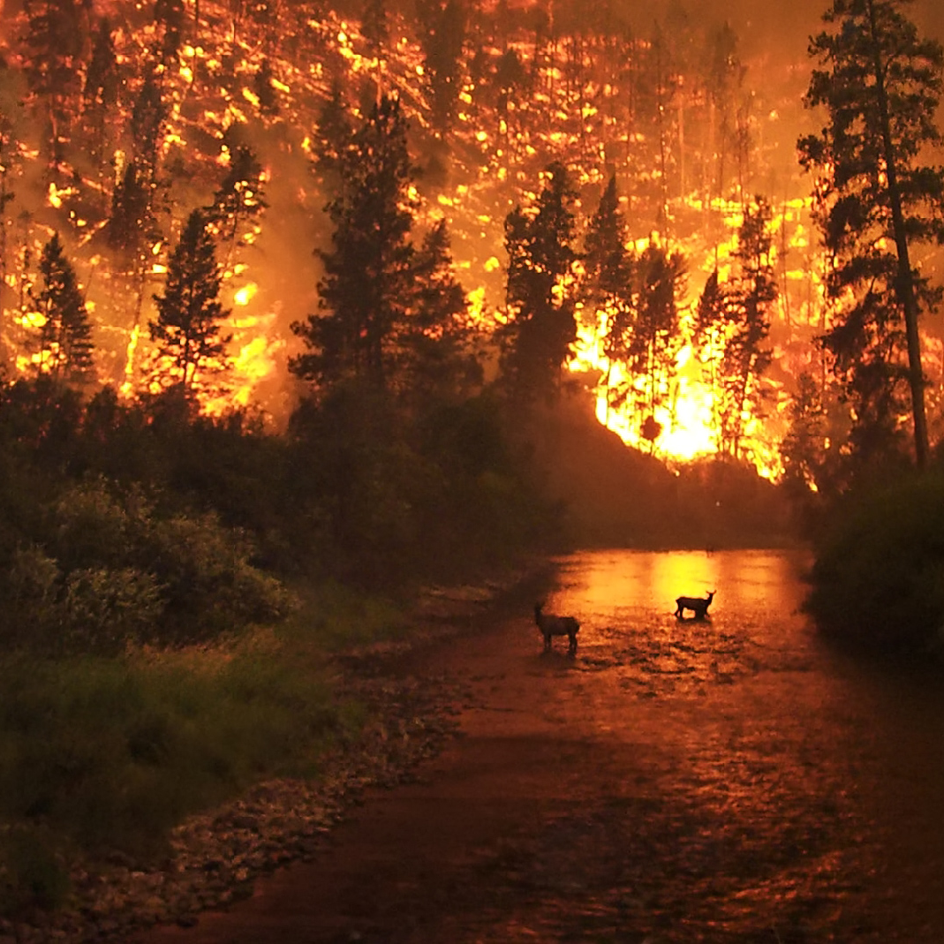
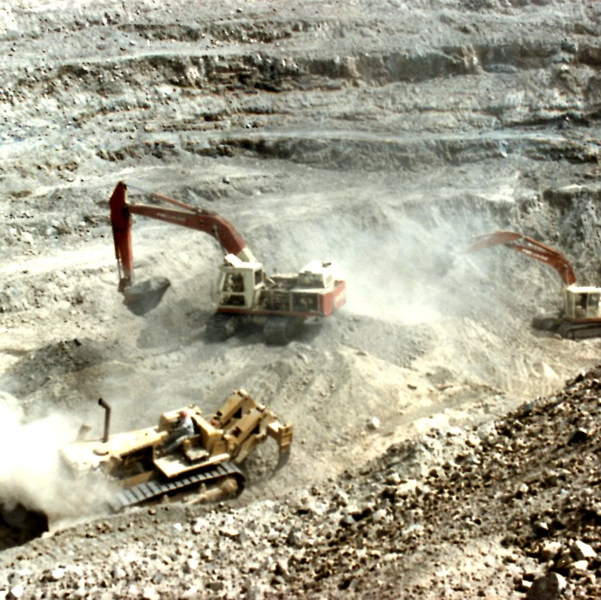
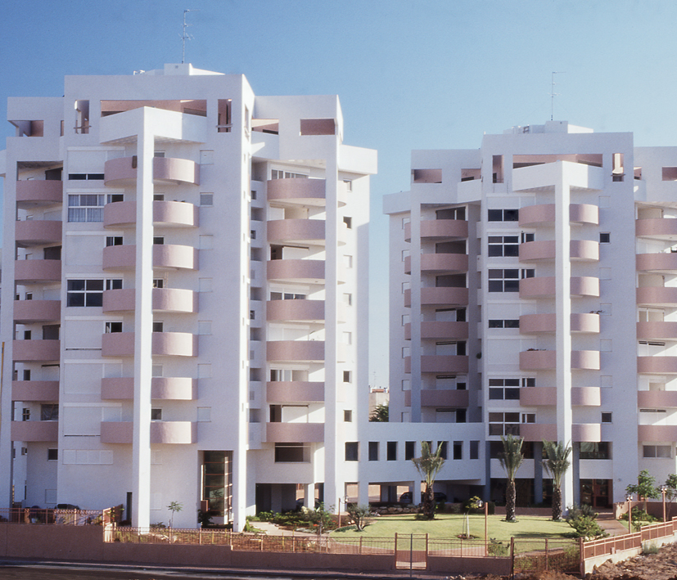
Causes of deforestation?
Farming (land cleared for crops to be planted/ agricultural expansions)
Natural disasters (wildfires and hurricanes)
Cattle and cow breeding
Mining and oil extraction out of the land
Cleared land used for housing
.

Slide 5
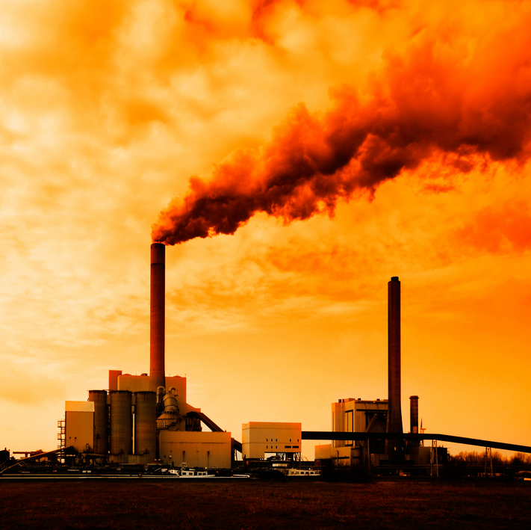
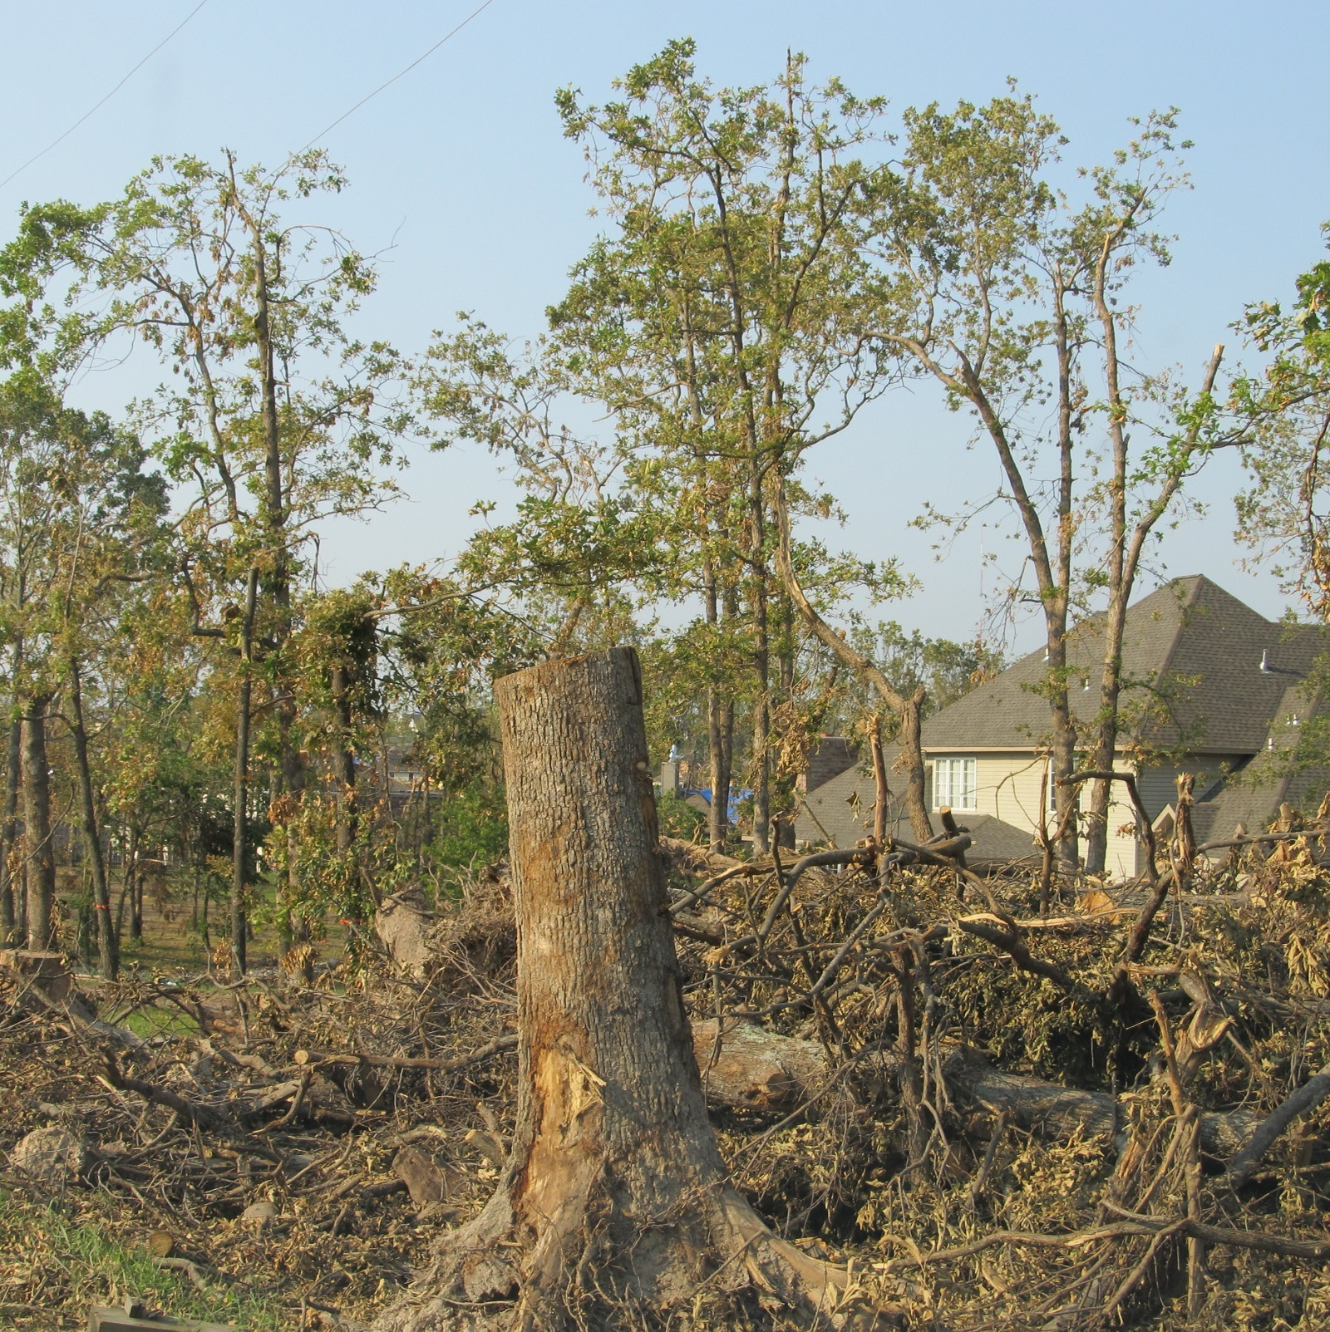
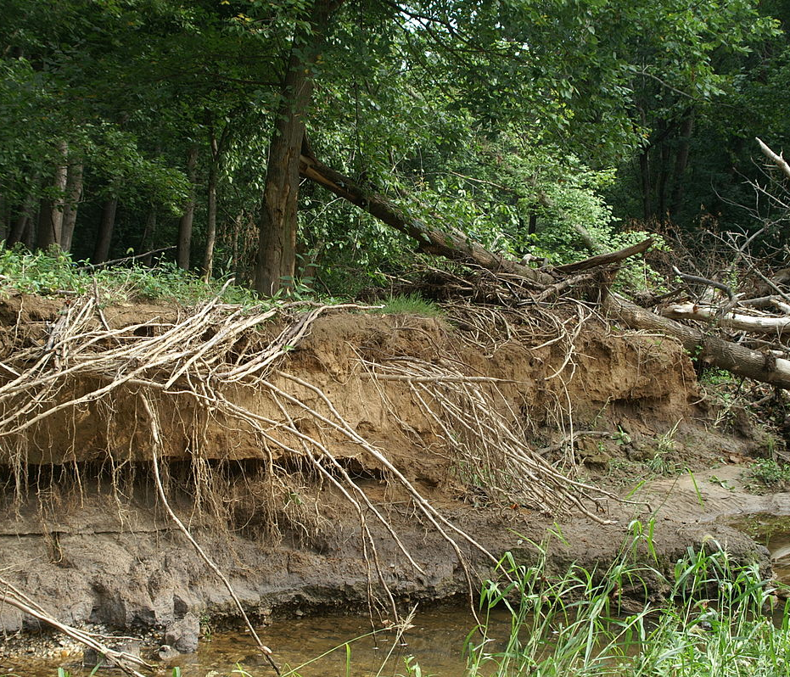
Effects of deforestation!
Desertification
Erosion
Climate change
Agricultural changes
Increased greenhouse gasses throughout the atmosphere

Slide 6
Impact during 2000- 2010

Slide 7
The relationship between desertification and deforestation!
Deforestation is clearing all trees in a large area of land. Desertification is when a fertile plot of land becomes desert like, because of a drought or deforestation.

Slide 8
Climate Change!
Climate change can increase the rate of deforestation. This is because, the increased amount of heat in the atmosphere causes the wrong conditions for a tree to live in. Therefor, there is a relationship.
This Photo by Unknown author is licensed under CC BY-ND.

Slide 9
The Amazon Rainforest!
Recently, the world's largest rainforest, the Amazon, caught on fire because of loggers and farmers trying to clear the land. The fires spread all through-out the forest with an increase of 80% from previous years.

Slide 10
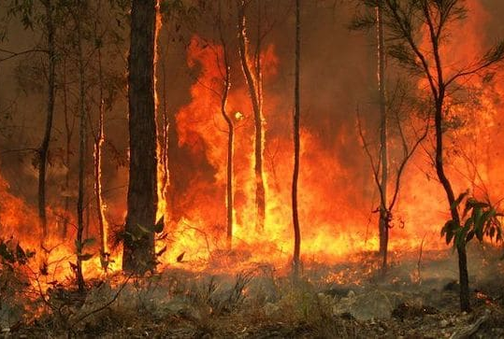
Australian bush fires!
In Australia, many of the forest's bushes have caught on fire and started spreading at an alarming rate. Causing over 24 MILLION acres of land and over a BILLION animals killed due to the devastation. Both this and The Amazon have been due to deforestation.

