Slide 1
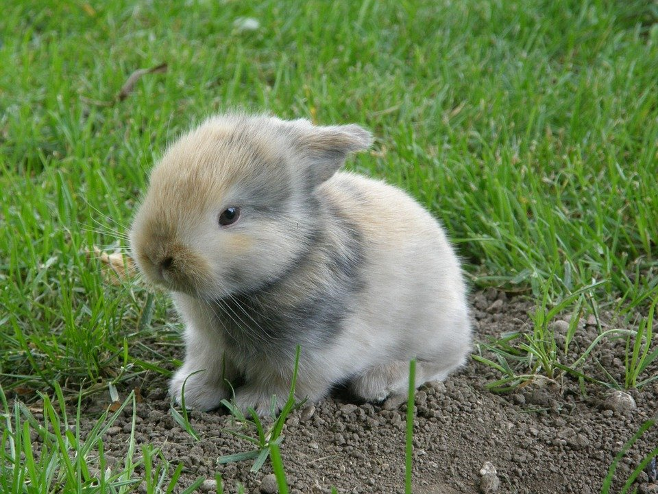
Feel free to write notes before we start

Slide 2
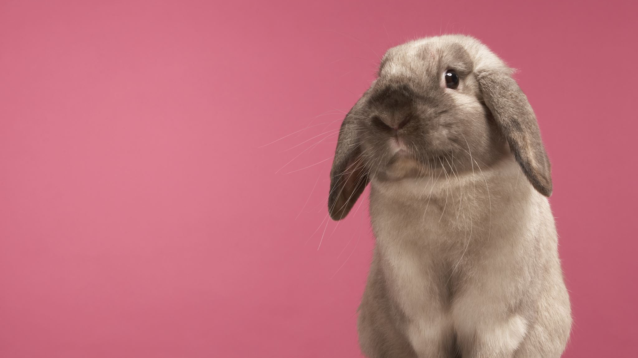
Facts about rabbits
By Dallas Sherman

Slide 3
Do you know that female rabbits are called does.
This Photo by Unknown author is licensed under CC BY-SA.

Slide 4
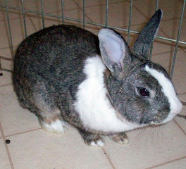
Do you know that male rabbits are called bucks.
This Photo by Unknown author is licensed under CC BY-NC-ND.

Slide 5
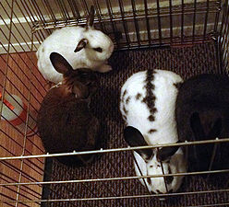
Do you know that rabbits live in groups
This Photo by Unknown author is licensed under CC BY-SA.

Slide 6
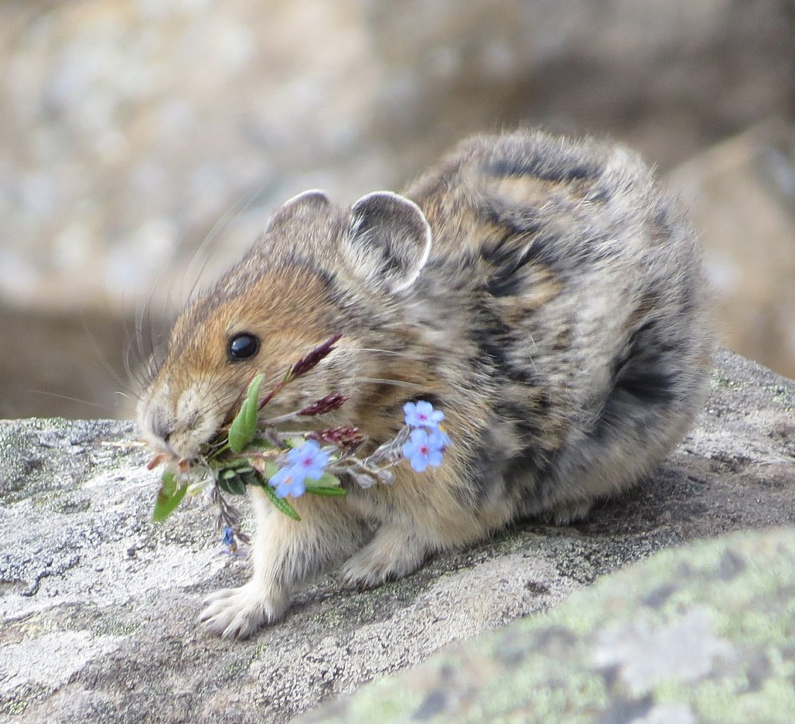
Do you know that rabbits live North America
This Photo by Unknown author is licensed under CC BY-SA.

Slide 7
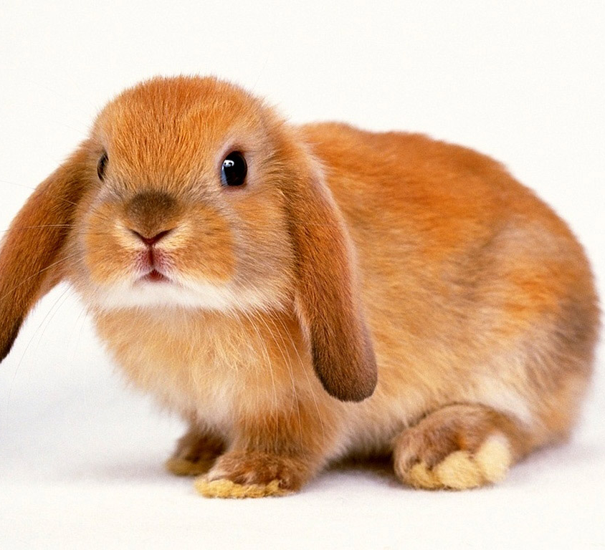
Do you know rabbits life span is 1 to 2 years in the wild.

Slide 8
Some rabbits are as big as a toddler.
This Photo by Unknown author is licensed under CC BY-SA.

Slide 9
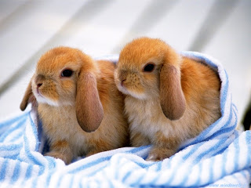
Rabbits have long ears, 10cm and 4in.
This Photo by Unknown author is licensed under CC BY-NC-ND.

Slide 10
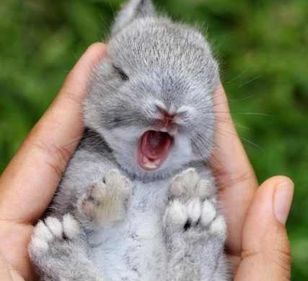
Rabbits daily sleep is 8.4 hours .
This Photo by Unknown author is licensed under CC BY-SA-NC.

Slide 11
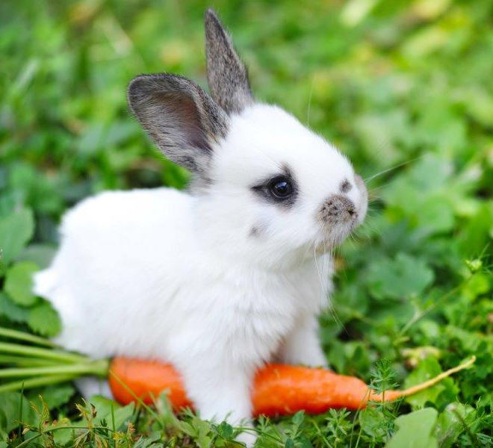
Did you know that rabbits can't live off carrots
This Photo by Unknown author is licensed under CC BY.

Slide 12
Baby rabbits are called kittens
This Photo by Unknown author is licensed under CC BY-NC-ND.

Slide 13
Think, do you have any questions

Slide 14
Thank you for listening. Have a nice day. Hope you enjoyed it.

